Slide 1
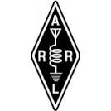

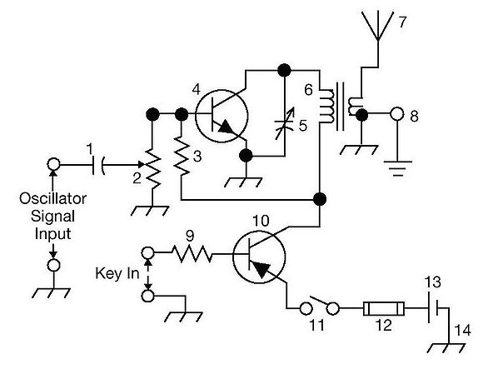
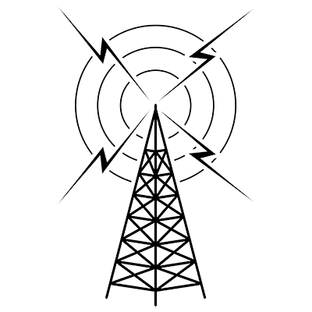
THE
ARRL
TENTH EDITION
GENERAL CLASS
LICENSE COURSE
FOR
HAM RADIO
All You Need to Pass Your General Class Exam!

Slide 2
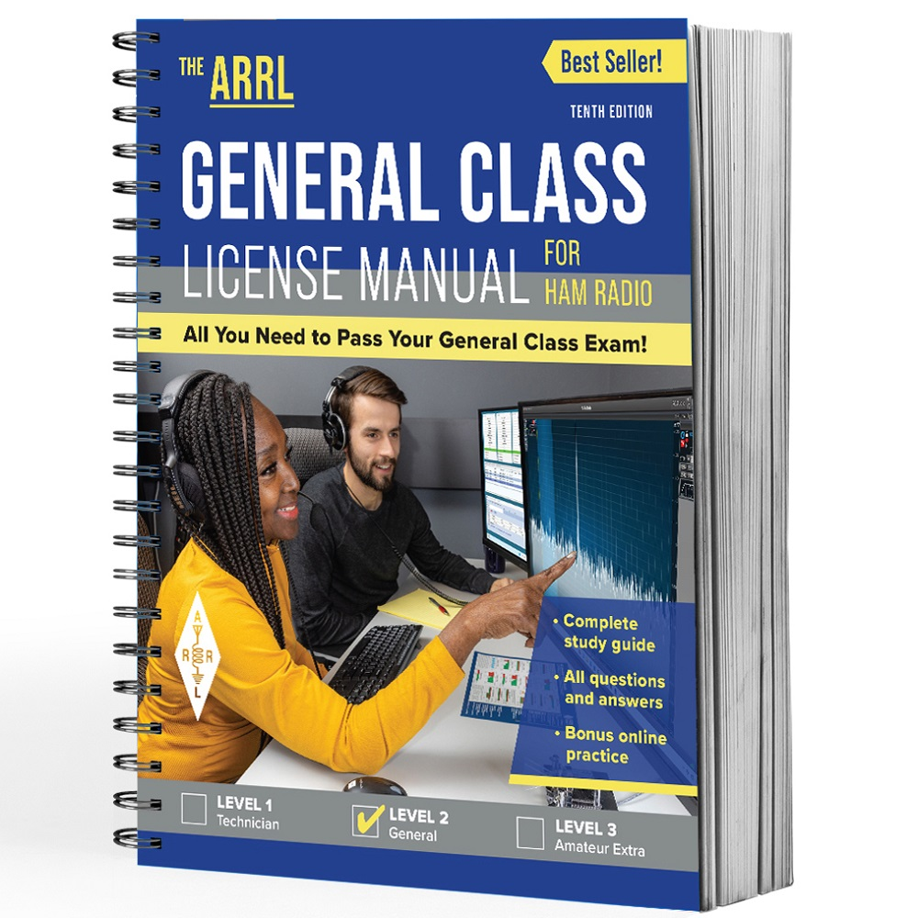
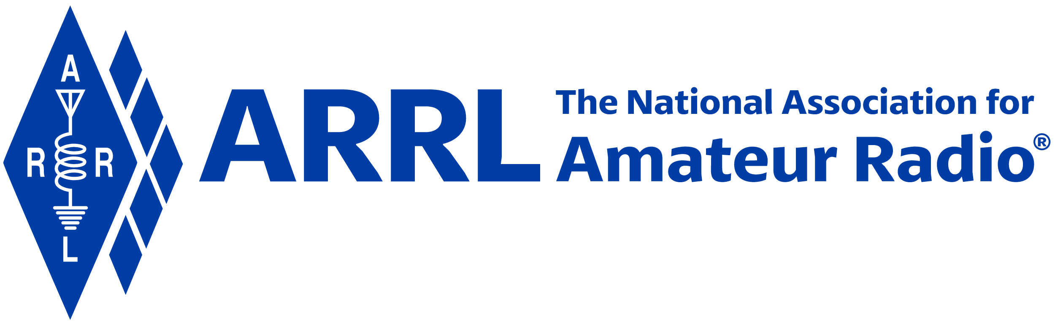
Resource & Reference
www.arrl.org/shop/Licensing-Education-and-Training

Slide 3
Chapter 9 Part 1 of 1 ARRL General Class Electrical and RF Safety Sections 9.1, 9.2, 9.3 Electrical Safety, RF Exposure, Outdoor Safety

Slide 4
Section 9.1: Electrical Safety Preventing Electric Shock
Have a master OFF/ON switch for station and workbench
Clearly labeled and somewhat away from the equipment
Don’t put yourself in a position to be shocked
When working inside equipment, remove, insulate, or secure loose wires and cables
Use grounding stick to remove charge from capacitors

Slide 5
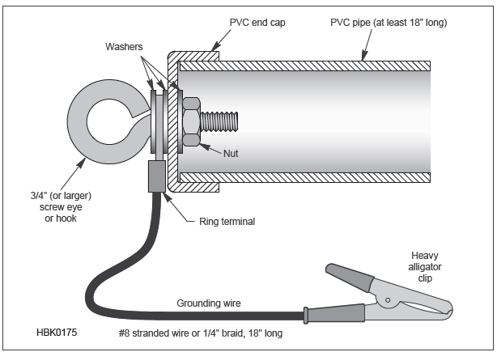
Figure 9.1: Diagram of a Grounding Stick
A grounding stick is touched to all circuitry inside an enclosure to insure that no high voltage is present. The alligator clip is attached to an electrical ground and the eyebolt is put in contact with the circuitry.

Slide 6
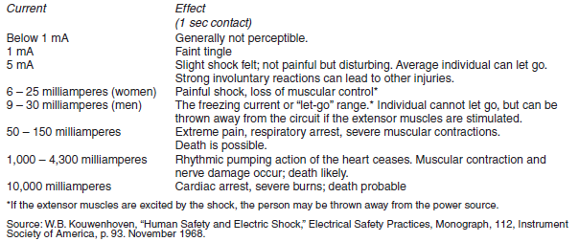
Table 9.1: Effects of Electric Current Through the Body of an Average Person

Slide 7
Soldering Safety
Primarily lead-based; tin added to lower melting point
Lead is a known toxin
Solder in a well-ventilated area
Rosin flux smoke likely not good for you in high doses
When finished, wash hands to remove solder or flux residue
As of 2006, environmental regulations were passed for solder to eventually be lead-free (leaded solder still available)
Lead-free solder melts at significantly higher temperature than traditional “60/40” solder (60% tin / 40% lead) … greater risk of damaging heat-sensitive components

Slide 8
PRACTICE QUESTIONS

Slide 9
Which of the following is a danger from lead-tin solder?
Lead can contaminate food if hands are not washed carefully after handling the solder
High voltages can cause lead-tin solder to disintegrate suddenly
Tin in the solder can “cold flow,” causing shorts in the circuit
RF energy can convert the lead into a poisonous gas
G0B10 (A) Page 9-3
9

Slide 10
Wiring Practices
National Electrical Code Handbook contains details for handling ac wiring in home and station
Use local building codes to ensure home is properly wired to meet special local conditions
Standard wire color conventions
Hot: Red or Black insulation, connect to brass terminal or screw
Neutral: White insulation, connect to silver terminal or screw
Ground: Green insulation or bare wire, connect to green or bare terminal or screw
WARNING: Don’t run antenna feed lines over power lines or service drops from a transformer to the house.

Slide 11
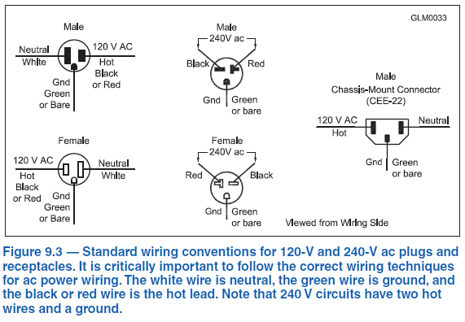
Fig 9.3
Standard Wiring Conventions
House AC wiring, most common sizes are #12 AWG for 20 A circuits and #14 AWG for 15 A circuits. See Table 9.2.
Use fuse or circuit breaker in the hot conductor for 120 V circuits or both hot conductors of a 240 V circuit using three or four wires.

Slide 12
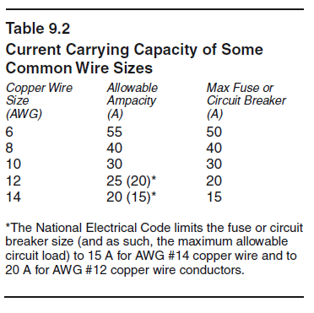
Table 9.2
The rating of wire to carry current is called its ampacity.
When you are finished with the wiring job, verify that you have the connections correct by using an ac circuit tester.

Slide 13
Fuses and Circuit Breakers
Interrupt excessive current flow
Fuses do so by melting a short length of metal
Circuit breakers act like fuses and “trip” when current overloads occur
Use properly sized fuses and circuit breakers
When installing fuses or circuit breakers in an ac wiring circuit, be sure to place them only in the correct lines (never in the neutral or ground)
Be sure there is a fuse or circuit breaker in the hot conductor for 120 V circuits or both hot conductors of a 240 V circuit

Slide 14
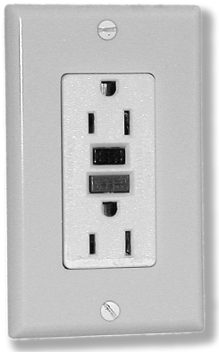
Ground fault circuit interrupter (GFCI) circuit breakers
Used in ac power circuits to prevent shock hazards
Trips if imbalance is sensed in currents carried by hot and neutral conductors
Sensitive to just a few milliamperes (mA) of imbalance between hot and neutral, well below threshold for electrical injury

Slide 15
Safety Interlock
Switch that prevents dangerous voltages or intense RF from being present when a cabinet or enclosure is opened
Several types …
Physically disconnects high voltage (HV) or RF when activated
Shorts or grounds HV circuit when activated, possibly blowing a circuit breaker or fuse in a power supply

Slide 16
PRACTICE QUESTIONS

Slide 17
Which wire or wires in a four-conductor 240 VAC circuit should be attached to fuses or circuit breakers?
Only the hot wires
Only the neutral wire
Only the ground wire
All wires
G0B01 (A) Page 9-5
17

Slide 18
According the National Electrical Code, what is the minimum wire size that may be used safely for wiring with a 20-ampere circuit breaker?
AWG number 20
AWG number 16
AWG number 12
AWG number 8
G0B02 (C) Page 9-5
18

Slide 19
Which size of fuse or circuit breaker would be appropriate to use with a circuit that uses AWG number 14 wiring?
30 amperes
25 amperes
20 amperes
15 amperes
G0B03 (D) Page 9-5
19

Slide 20
Which of the following conditions will cause a ground fault circuit interrupter (GFCI) to disconnect AC power?
Current flowing from one or more of the hot wires to the neutral wire
Current flowing from one or more of the hot wires directly to ground
Overvoltage on the hot wires
All these choices are correct
G0B05 (B) Page 9-6
20

Slide 21
Which of the following is covered by the National Electrical Code?
Acceptable bandwidth limits
Acceptable modulation limits
Electrical safety of the station
RF exposure limits of the human body
G0B06 (C) Page 9-4
21

Slide 22
What is the purpose of a power supply interlock?
To prevent unauthorized changes to the circuit that would void the manufacturer’s warranty
To shut down the unit if it becomes too hot
To ensure that dangerous voltages are removed if the cabinet is opened
To shut off the power supply if too much voltage is produced
G0B12 (C) Page 9-6
22

Slide 23
Generator Safety
Fueling and ventilation problems cause more injuries associated with generators than from any other cause
Install generators outdoors
Carbon monoxide (CO) in exhaust can quickly build up to toxic levels
When using generators regularly, install CO detector alarms in living and working areas
Generator output connected directly to a home’s wiring system must have the ability to disconnect power service from utility lines
Generators should always be shut off when refueling to avoid igniting fumes or splashed liquid from the spark plug
A fire extinguisher should be kept near the generator and separated from the fuel

Slide 24
PRACTICE QUESTIONS

Slide 25
Which of the following is true of an emergency generator installation?
The generator should be operated in a well-ventilated area
The generator must be insulated from ground
Fuel should be stored near the generator for rapid refueling in case of an emergency
All these choices are correct
G0B09 (A) Page 9-7
25
25

Slide 26
Lightning
Goals of lightning protection:
Provide fire prevention for your home
Reduce or prevent electrical damage to your equipment
Use metal entry panel where signal & control cables enter the house
Panel should be grounded nearby with a heavy, short metal strap
Ground rod must be bonded to the ac service entry ground rod outside the building with a heavy conductor
Lightning arrestors should be installed at the entry panel (where feed line enters)
Grounding wires and straps should be as short and direct as possible
Do not use solder to make ground connections (solder joints could melt if hit with a lightning-sized current -- use mechanical clamps, brazing, or welding)
All towers, masts, and antennas should be grounded

Slide 27
PRACTICE QUESTIONS

Slide 28
Why should soldered joints not be used in lightning protection ground connections?
A soldered joint will likely be destroyed by the heat of a lightning strike
Solder flux will prevent a low conductivity connection
Solder has too high a dielectric constant to provide adequate lightning protection
All these choices are correct
G4C07 (A) Page 9-8
28
28

Slide 29
Where should the station’s lightning protection ground system be located?
As close to the station equipment as possible
Outside the building
Next to the closest power pole
Parallel to the water supply line
G0B04 (B) Page 9-8
29
29

Slide 30
Which of the following is required for lightning protection ground rods?
They must be bonded to all buried water and gas lines
Bends in ground wires must be made as close as possible to a right angle
Lightning grounds must be connected to all ungrounded wiring
They must be bonded together with all other grounds
G0B11 (D) Page 9-8
30
30

Slide 31
Where should lightning arrestors be located?
Where the feed lines enter the building
On the antenna, opposite the feed point
In series with each ground lead
At the closest power pole ground electrode
G0B13 (A) Page 9-8
31
31

Slide 32
Section 9.2 RF Exposure
At high power levels, for some frequencies, the amount of energy that the body absorbs can be a problem
Maximum permissible exposure (MPE): Maximum intensity of RF radiation to which a human being may be exposed
Factors to consider when estimating MPE: transmitted power level or density, frequency, average exposure time, and duty cycle of the transmission (power density & frequency are primary ones)
Stations with a time-averaged transmission of more than one milliwatt are subject to the FCC's RF exposure rules; if your station exceeds the exemption criteria, you will need to evaluate it according to the FCC OET Bulletin 65

Slide 33
Power Density
Heating from exposure to RF signals is caused by the body tissue absorbing RF energy
Measured in mW/cm² (milliwatts per square centimeter)
RF field strengths can also be measured in V/m and A/m, (mW/cm² is the most useful for amateur requirements)
Power density is highest near antennas and in the directions in which antennas have the most gain
Decreasing transmitter power and increasing distance from an antenna lowers power density (lowers RF energy), and vice versa

Slide 34
Absorption and Limits
SAR (specific absorption rate): Rate at which energy is absorbed from the power to which the body is exposed
Best measure of RF exposure, but difficult to measure
Varies with frequency, power density, average amount of exposure, and duty cycle of transmission
Depends on frequency and size of the body or body part affected; highest where the body and body parts are naturally resonant
Safe levels of SAR based on demonstrated hazards have been established for by the FCC in the form of maximum permissible exposure (MPE) limits

Slide 35
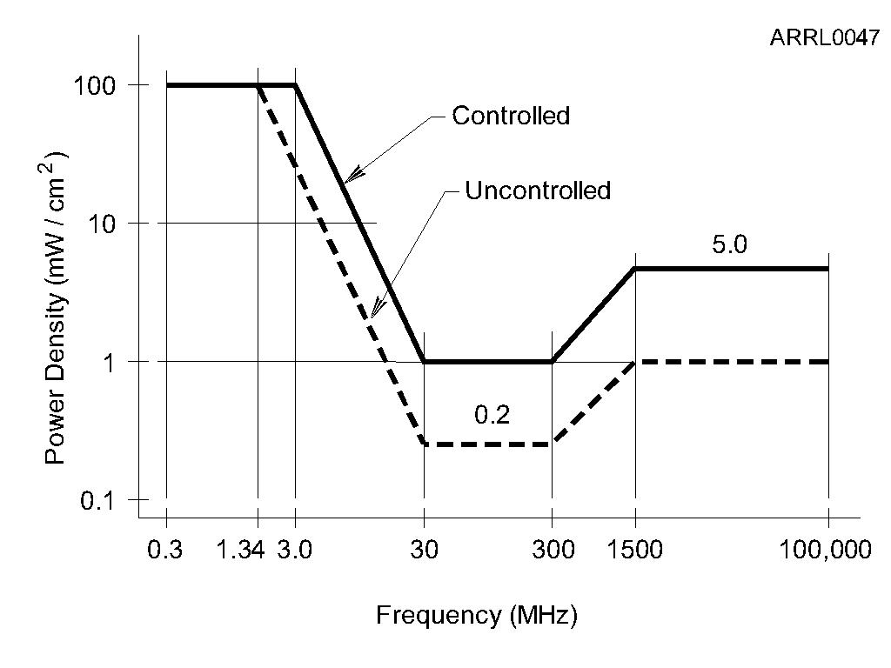
Fig 9.9
Maximum Permissible Exposure
(MPE) limits vary with frequency because the body responds differently to energy at different frequencies. The controlled and uncontrolled limits refer to the environment in which people are exposed to the RF energy.
These take into account the variations in the body’s sensitivity to RF energy at different frequencies. Also see Table 9.3 (next slide).

Slide 36
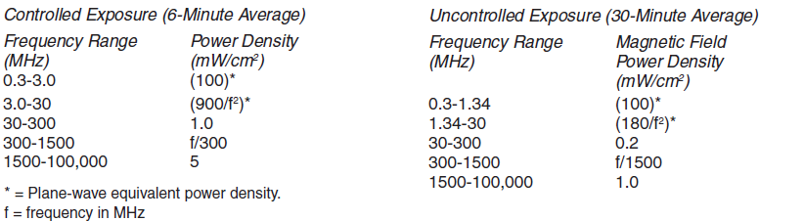
Limits for Occupational/Controlled Exposure (Combined Table 9.3A & 9.3B)
Controlled Exposure Limits apply to individuals trained in RF exposure (such as licensed amateurs)

Slide 37
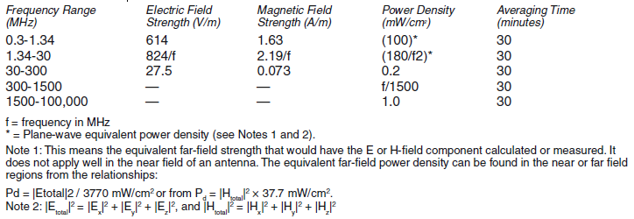
Table 9.3B Limits for General Population/Uncontrolled Exposure
Uncontrolled Exposure Limits apply to individuals NOT trained in RF exposure (general public)

Slide 38
Duty Cycle & Controlled/Uncontrolled Environments
Exposure to RF energy is averaged over fixed time intervals
Time-averaging evaluates total RF exposure over a fixed time interval
Two types of averaging periods: Controlled & uncontrolled
Controlled = You’re aware of your exposure and are expected to take reasonable steps to minimize
Controlled Environment Examples: Transmitting facilities, near antennas
Uncontrolled environments: General public has access
People in uncontrolled environments are not aware of their exposure, but are much less likely to receive continuous exposure

Slide 39
Duty Cycle
Ratio of the time the transmitter is ON to the total time during the exposure (max = 100%)
Same as duty factor, but duty factor is expressed as a fraction (0.25 instead of 25%)
A lower transmission duty cycle permits greater short-term exposure levels for a given average exposure (called operational duty cycle)
The less time the transmitter is ON, the lower the average exposure, permitting greater short-term exposure levels for a given average exposure
Along with operational duty cycle, the different modes themselves have different emission duty cycles (see Table 9.4)

Slide 40
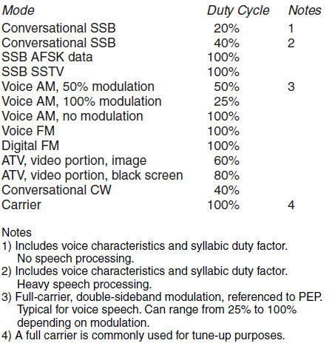
Table 9.4
Operating Duty Factor of Modes Commonly Used by Amateurs
For most amateurs operating, listening and transmitting time are about the same, so operating duty cycle is rarely higher than 50%.

Slide 41
Calculating Average Duty Cycle Power
A station is using SSB without speech processing, transmitting and listening for equal amounts of time and with transmitted power of 150 W. Calculate the average power output.
Average Duty Cycle Power =
Transmitted Power × Emission Duty Cycle × Operating Duty Cycle
Transmitted Power = 150 W (given in the problem statement)
See Table 9.4 for Emission Duty Cycle. For conversational SSB without speech processing = 20%
Operating Duty Cycle = 50% (half time transmitting, half receiving)
Average Duty Cycle Power = 150 W × 20% × 50% = 15 W

Slide 42
Estimating Exposure & Station Evaluation (ERP = Effective Radiated Power)
All fixed amateur stations must evaluate their capability to cause RF exposure, no matter whether they use high or low power
Limits vary with frequency and PEP
Required to perform the evaluation if your power exceeds the levels shown for any band (Table 9.5A)
Table 9.5B gives the minimum distances from the antenna for which the FCC exemptions can be used for most amateur bands
Exposure evaluation is performed by 3 different methods:
Measuring RF field strength with calibrated meters and calibrated antennas, or
Use computer modeling/calculation per FCC OET Bulletin 65, or
Easiest way … ARRL’s online calculator … www.arrl.org/rf-exposure-calculator

Slide 43
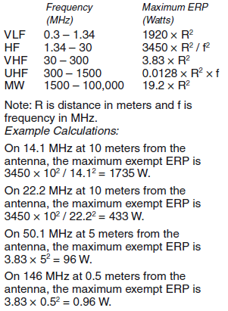
Table 9.5A
Maximum Exempt ERP
What you need to calculate RF exposure …
Power at the antenna, including adjustments for duty cycle and feed line loss
Antenna type (or gain)
Antenna height above ground
Operating frequency

Slide 44
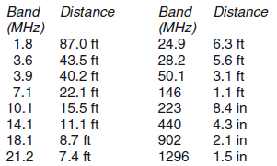
Table 9.5B
Minimum Exemption Distances (λ/2π)

Slide 45
Exposure Safety Measures / Good Practices
Locate or move antennas away from where people can be exposed to excessive RF fields … locate antenna away from property lines and place fence around base of ground-mounted antennas
Don’t point gain antennas where people are likely to be; use beam antennas to direct RF energy away from people
When using stealth, attic, or other indoor antennas, make sure MPE limits are not exceeded in living quarters
On VHF and UHF, place mobile antennas on roof or trunk of car to maximize shielding of passengers
Use dummy load or dummy antenna when testing a transmitter
Reduce the power and duty cycle of your transmissions

Slide 46
PRACTICE QUESTIONS

Slide 47
What is one way that RF energy can affect human body tissue?
It heats body tissue
It causes radiation poisoning
It causes the blood count to reach a dangerously low level
It cools body tissue
G0A01 (A) Page 9-9
47

Slide 48
Which of the following is used to determine RF exposure from a transmitted signal?
Its duty cycle
Its frequency
Its power density
All these choices are correct
G0A02 (D) Page 9-9
48

Slide 49
How can you determine that your station complies with FCC RF exposure regulations?
By calculation based on FCC OET Bulletin 65
By calculation based on computer modeling
By measurement of field strength using calibrated equipment
All these choices are correct
G0A03 (D) [97.13(c)(1)] Page 9-13
49

Slide 50
What does “time averaging” mean when evaluating RF radiation exposure?
The average amount of power developed by the transmitter over a specific 24-hour period
The average time it takes RF radiation to have any long-term effect on the body
The total time of the exposure
The total RF exposure averaged over a certain period
G0A04 (D) Page 9-11
50

Slide 51
What must you do if an evaluation of your station shows that the RF energy radiated by your station exceeds permissible limits for possible human absorption?
Take action to prevent human exposure to the excessive RF fields
File an Environmental Impact Statement (EIS-97) with the FCC
Secure written permission from your neighbors to operate above the controlled MPE limits
All these choices are correct
G0A05 (A) [97.13(c)(2), 1.1307(b)] Page 9-13
51

Slide 52
What must you do if your station fails to meet the FCC RF exposure exemption criteria?
Perform an RF Exposure Evaluation in accordance with FCC OET Bulletin 65
Contact the FCC for permission to transmit
Perform an RF exposure evaluation in accordance with World Meteorological Organization guidelines
Use an FCC-approved band-pass filter
G0A06 (A) [97.13(c)(2), 1.1307(1)(b)(3)(i)] Page 9-9
52

Slide 53
What is the effect of modulation duty cycle on RF exposure?
A lower duty cycle permits greater power levels to be transmitted
A higher duty cycle permits greater power levels to be transmitted
Low duty cycle transmitters are exempt from RF exposure evaluation requirements
High duty cycle transmitters are exempt from RF exposure requirements
G0A07 (A) Page 9-11
53

Slide 54
Which of the following steps must an amateur operator take to ensure compliance with RF safety regulations?
Post a copy of FCC Part 97.13 in the station
Notify neighbors within a 100-foot radius of the antenna of the existence of the station and power levels
Perform a routine RF exposure evaluation and prevent access to any identified high exposure areas
All these choices are correct
G0A08 (C) [97.13(c)(2)] Page 9-12
54

Slide 55
What type of instrument can be used to accurately measure an RF field strength?
receiver with digital signal processing (DSP) noise reduction
A calibrated field strength meter with a calibrated antenna
An SWR meter with a peak-reading function
An oscilloscope with a high-stability crystal marker generator
G0A09 (B) Page 9-13
55

Slide 56
What should be done if evaluation shows that a neighbor might experience more than the allowable limit of RF exposure from the main lobe of a directional antenna?
Change to a non-polarized antenna with higher gain
Use an antenna with a higher front-to-back ratio
Take precautions to ensure that the antenna cannot be pointed in their direction when they are present
All these choices are correct
G0A10 (C) Page 9-13
56

Slide 57
What precaution should you take if you install an indoor transmitting antenna?
Locate the antenna close to your operating position to minimize feed-line radiation
Position the antenna along the edge of a wall to reduce parasitic radiation
Make sure that MPE limits are not exceeded in occupied areas
Make sure the antenna is properly shielded
G0A11 (C) Page 9-14
57

Slide 58
What stations are subject to the FCC rules on RF exposure?
All commercial stations; amateur radio stations are exempt
Only stations with antennas lower than one wavelength above the ground
Only stations transmitting more than 500 watts PEP
All stations with a time-averaged transmission of more than one milliwatt
G0A12 (D) [1.1307(1)(b)(3)(i)(A)] Page 9-9
58

Slide 59
Section 9.3: Outdoor Safety Installing Antennas
Place all antennas and feed lines well clear of power lines!
No part of antenna system should be closer than 10 feet from power lines
When working on roofs, trees, or towers, climbers and helpers should wear appropriate protective gear at all times … run through a safety checklist every time
Turn off and unplug all ac equipment, locking circuits out and tagging them if possible
Transmitters should be off and disconnected from feed line to avoid shock or excessive RF exposure
Belts and harnesses must be within their service life and adequately rated for weight
Check the weather report!
Take your time

Slide 60
PRACTICE QUESTIONS

Slide 61
Which of these choices should be observed when climbing a tower using a safety harness?
Always hold on to the tower with one hand
Confirm that the harness is rated for the weight of the climber and that it is within its allowable service life
Ensure that all heavy tools are securely fastened to the harness
All these choices are correct
G0B07 (B) Page 9-16
61

Slide 62
What should be done before climbing a tower that supports electrically powered devices?
Notify the electric company that a person will be working on the tower
Make sure all circuits that supply power to the tower are locked out and tagged
Unground the base of the tower
All these choices are correct
G0B08 (B) Page 9-16
62

Slide 63
END OF CHAPTER 9 PART 1 OF 1

Slide 64
Slides created by …
Jerry D. Kilpatrick
KØILP (Amateur Radio)
PGØØØ72373 (Commercial Operator)
K0ILP.NC@gmail.com
Feel free to contact me if you find errors or have suggestions for improvement.

