Slide 1
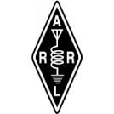

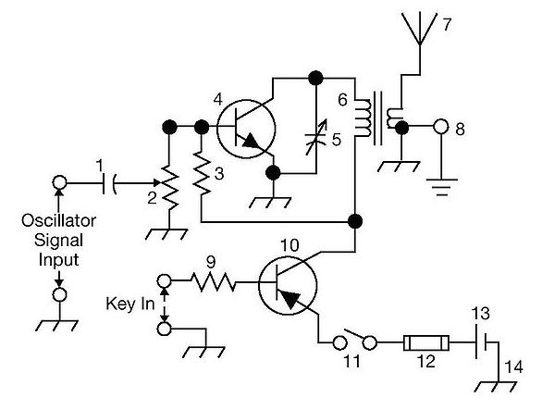
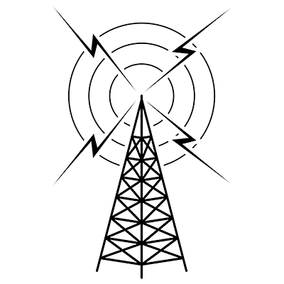
THE
ARRL
TENTH EDITION
GENERAL CLASS
LICENSE COURSE
FOR
HAM RADIO
All You Need to Pass Your General Class Exam!

Slide 2

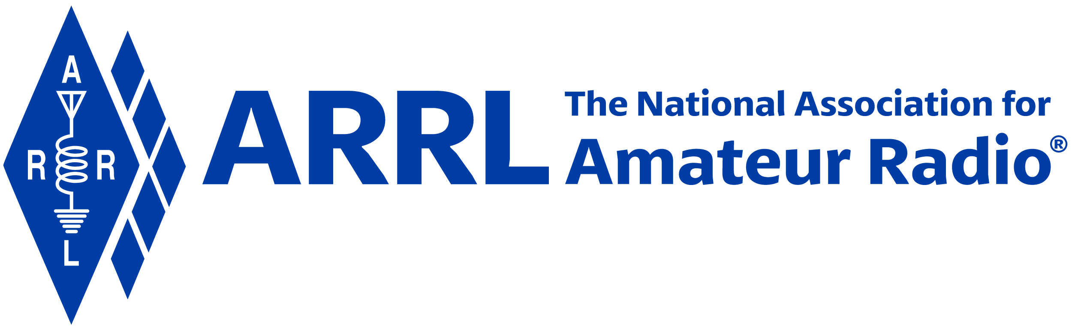
Resource & Reference
www.arrl.org/shop/Licensing-Education-and-Training

Slide 3
Chapter 8 Part 1 of 1 ARRL General Class Propagation Sections 8.1, 8.2, 8.3 The Ionosphere, The Sun, Scatter Modes

Slide 4
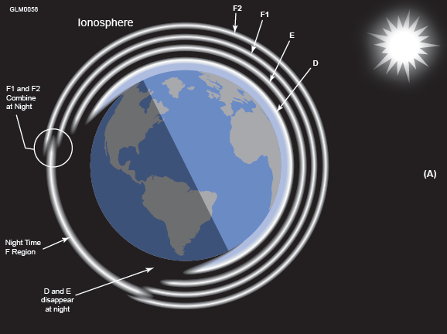
Section 8.1 The Ionosphere
Upper reaches of atmosphere gets thinner with distance
Beginning at about 30 miles, remaining gas is thin enough for ionization to occur
This region of the atmosphere becomes a very weak conductor

Slide 5
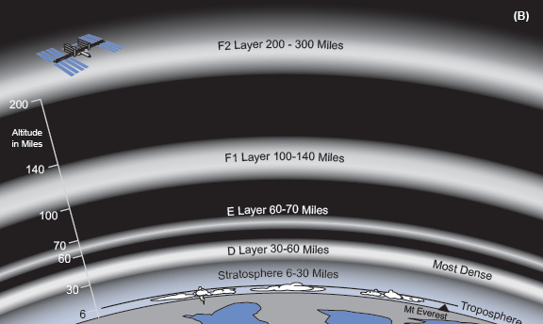
Ionosphere (cont.)
D layer (30 to 60 miles in altitude) is only present when illuminated by the sun
Disappears at night because ions and free electrons are close enough together to recombine quickly when no UV is present, returning to a neutral condition
At night, the D and E regions disappear and the F1 and F2 regions combine to form a single F region
Figure 8.1 — The ionosphere consists of several regions of ionized particles at different heights above the Earth.

Slide 6
Ionosphere (cont.)
E layer (60 to 70 miles in altitude) acts similarly to D
Higher and less dense than D region, enables it to last longer after sunset
F layer (100 to 300 miles in altitude), least dense of the three
Remains partially ionized at night
During the day, F region splits into F1 and F2
Height of the F region varies quite a bit with local time, season, latitude, and solar activity
At any particular location, the stronger the illumination from the sun, the higher the F2 layer will be, so its maximum height is reached at noon when the sun is overhead

Slide 7
Reflection
Ionosphere refracts radio waves (it’s a weak conductor)
Refraction amount depends on amount of ionization and wave frequency
The HIGHER the ionization, the more the refraction
The LOWER the frequency, the more the refraction
HF signals … relatively good refraction … REFLECTED back to the Earth’s surface
VHF & UHF signals … essentially no refraction
See Figure 8.2
Each reflection is a hop; allows signal to be received hundreds or thousands of miles away (called skywave; propagation via the ionosphere is called skip)

Slide 8
Reflection (cont.)
The higher the region from which the reflection takes place, the longer the hop
Waves reflected from F2 layer travel up to 2,500 miles before returning to ground
Hops from E layer are shorter, up to 1,200 miles, because of lower reflecting height
Some combinations of frequency and ionization level result in weak bending … wave must leave the Earth’s surface at a low enough angle for the bending of the wave to send it back
Highest takeoff angle at which a wave can be returned to Earth is the critical angle
Critical angle depends on ionospheric conditions and frequency

Slide 9
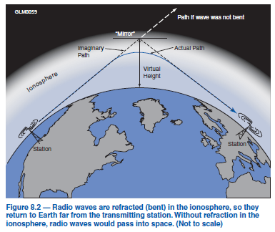
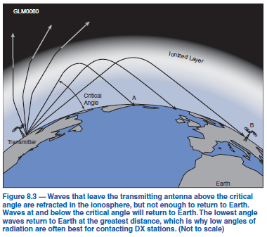
Critical Angle
Highest takeoff angle at which a wave can be returned to Earth
Critical frequency: Highest frequency on which a wave transmitted straight up will be returned to Earth.

Slide 10
Absorption
Enemy of propagation is absorption
In D and E regions, waves passing through the denser gas are partially absorbed (D region is not very good at refraction)
In HF bands below 10 MHz, AM broadcast bands, and at lower frequencies, the D region completely absorbs radio waves during the day, preventing those waves from returning to Earth
Absorption increases in daytime and when solar UV is more intense
QUESTION: When is the best time to transmit on HF below 10 MHz?
Answer: At night!

Slide 11
Noise
Noise is another enemy of propagation (covers up weak signals)
Stronger at frequencies below VHF (due to atmospheric disturbances)
Lower you go in frequency, the stronger the noise or static
Varies seasonally
Most noticeable on lower frequency HF bands in the summer when atmospheric noise is strongest

Slide 12
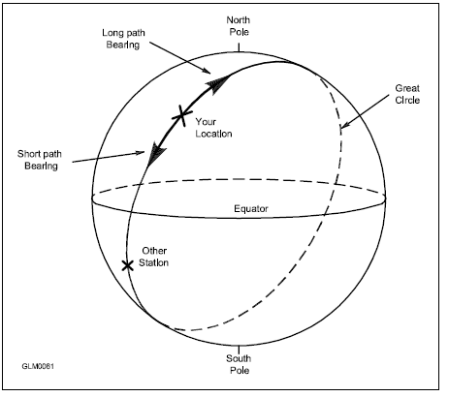
Long Path and Short Path
When ionosphere along short path does not support propagation, sometimes long path will
Occasionally, propagation over both long and short paths will be supported (at same time)
Unless the paths are almost equal there will be an echo (delayed signal arrives a fraction of a second later)
Round-the-world propagation: you can hear your own signal coming all the way around to your location about 1/7 of a second later!
25,000 miles divided by 186,000 miles/sec
This sketch of the Earth shows both great circle paths drawn between two stations. The bearings for the short path and the long path are shown from the Northern Hemisphere station.

Slide 13
PRACTICE QUESTIONS

Slide 14
How is a directional antenna pointed when making a “long-path” contact with another station?
Toward the rising sun
Along the grayline
180 degrees from the station’s short-path heading
Toward the north
G2D06 (C) Page 8-6
14

Slide 15
What is a characteristic of skywave signals arriving at your location by both short-path and longpath propagation?
Periodic fading approximately every 10 seconds
Signal strength increased by 3 dB
The signal might be cancelled causing severe attenuation
A slightly delayed echo might be heard
G3B01 (D) Page 8-6
15

Slide 16
What is the approximate maximum distance along the Earth’s surface normally covered in one hop using the F2 region?
180 miles
1,200 miles
2,500 miles
12,000 miles
G3B09 (C) Page 8-5
16

Slide 17
What is the approximate maximum distance along the Earth’s surface normally covered in one hop using the E region?
180 miles
1,200 miles
2,500 miles
12,000 miles
G3B10 (B) Page 8-5
17

Slide 18
Which ionospheric region is closest to the surface of Earth?
The D region
The E region
The F1 region
The F2 region
G3C01 (A) Page 8-2
18

Slide 19
What is meant by the term “critical frequency” at a given incidence angle?
The highest frequency which is refracted back to Earth
The lowest frequency which is refracted back to Earth
The frequency at which the signal-to-noise ratio approaches unity
The frequency at which the signal-to-noise ratio is 6 dB
G3C02 (A) Page 8-5
19

Slide 20
Why is skip propagation via the F2 region longer than that via the other ionospheric regions?
Because it is the densest
Because of the Doppler effect
Because it is the highest
Because of temperature inversions
G3C03 (C) Page 8-5
20

Slide 21
What does the term “critical angle” mean, as applied to radio wave propagation?
The long path azimuth of a distant station
The short path azimuth of a distant station
The lowest takeoff angle that will return a radio wave to Earth under specific ionospheric conditions
The highest takeoff angle that will return a radio wave to Earth under specific ionospheric conditions
G3C04 (D) Page 8-5
21

Slide 22
Why is long-distance communication on the 40-, 60-, 80-, and 160-meter bands more difficult during the day?
The F region absorbs signals at these frequencies during daylight hours
The F region is unstable during daylight hours
The D region absorbs signals at these frequencies during daylight hours
The E region is unstable during daylight ho
G3C05 (C) Page 8-5
22

Slide 23
Which ionospheric region is the most absorbent of signals below 10 MHz during daylight hours?
The F2 region
The F1 region
The E region
The D region
G3C11 (D) Page 8-5
23

Slide 24
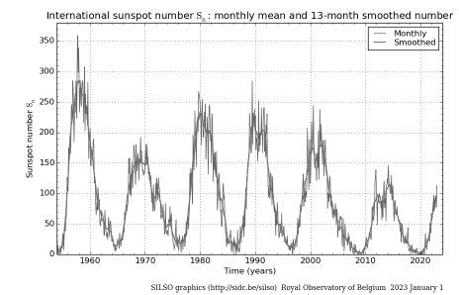
Section 8.2: The Sun Sunspots and Cycles
Ionosphere is dependent on solar UV to separate electrons from atoms
Much of the variation in UV radiation is due to sunspot activity
One complete sunspot cycle lasts about 11 years
When more sunspots are observed, more UV is being generated, creating more intense ionization and improving propagation on higher frequency bands above 10 MHz and even into lower VHF range
This graph shows the monthly mean sunspot numbers for several past cycles through October 2018. The NASA Solar Physics web page maintains complete data on the sunspot cycle.
In mid 2023, when this book is being published, Cycle 25 is heating up and propagation on 10 meters and other bands is increasing.

Slide 25
Sunspots and Cycles (cont.)
At peak of cycle, there may be sufficient solar UV to cause higher frequency bands (10 meters) to stay open for long-distance contacts at night
High ionization negatively impacts low frequency bands (80 and 160 m) because it increases absorption
When solar activity is low, lower HF bands have good propagation and higher HF bands above 20 MHz (15 m and up) are often closed
One band that seems to do well at all times in sunspot cycle is 20 meters (14 MHz), supporting daytime communications worldwide nearly every day

Slide 26
Table 8.1: Daytime/Nighttime HF Propagation
HF BAND (m) | DAYTIME | NIGHTTIME
160, 80, 60 | Local and regional to 100 – 200 miles | Local to long distance with DX best near sunset or sunrise at one or both ends of the contact
40, 30 | Local and regional to 300 – 400 miles | Short-range (20 or 30 miles) and medium distances (150 miles) to worldwide
20, 17 | Regional to long distance, opening at or near sunrise and closing at night | 20 meters is often open to the west at night and may be open 24 hours a day
15, 12, 10 | Primarily long distance (1000 miles and more), opening to the east after sunrise and to the west in the afternoon | 10 meters is often used for local communications 24 hours a day
Sunspots also seem to move across the sun’s surface because the sun rotates once every 28 days. That is why propagation conditions (good and bad) on the HF bands often repeat themselves in 28-day cycles as sunspots rotate back into view from Earth.

Slide 27
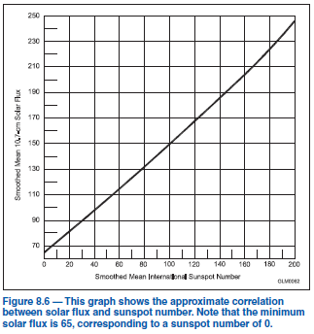
Measuring Solar Activity
Solar activity is so important to propagation and communications that it is monitored constantly by solar observatories worldwide
Sunspot Number: See Fig 8.6
Solar-Flux Index (SFI): Describes amount of 2800 MHz (λ = 10.7 cm) radio energy. Higher levels indicate higher solar activity and better HF propagation above 10 MHz (Fig 8.6)
K-index: Values from 0 to 9 represent the short-term stability of the Earth’s magnetic or geomagnetic field. Higher values indicate geomagnetic field is disturbed, which disrupts HF.
A-index: Gives a good picture of long-term geomagnetic field stability. Ranges from 0 (stable) to 400 (greatly disturbed). Calculated from K-index.

Slide 28
PRACTICE QUESTIONS

Slide 29
How does a higher sunspot number affect HF propagation?
Higher sunspot numbers generally indicate a greater probability of good propagation at higher frequencies
Lower sunspot numbers generally indicate greater probability of sporadic E propagation
A zero sunspot number indicates that radio propagation is not possible on any band
A zero sunspot number indicates undisturbed conditions
G3A01 (A) Page 8-8
29

Slide 30
Which of the following are least reliable for long-distance communications during periods of low solar activity?
80 meters and 160 meters
60 meters and 40 meters
30 meters and 20 meters
15 meters, 12 meters, and 10 meters
G3A04 (D) Page 8-8
30

Slide 31
What is the solar flux index?
A measure of the highest frequency that is useful for ionospheric propagation between two points on Earth
A count of sunspots that is adjusted for solar emissions
Another name for the American sunspot number
A measure of solar radiation at 10.7 centimeters wavelength
G3A05 (D) Page 8-9
31

Slide 32
At what point in the solar cycle does the 20-meter band usually support worldwide propagation during daylight hours?
At the summer solstice
Only at the maximum point of the solar cycle
Only at the minimum point of the solar cycle
At any point in the solar cycle
G3A07 (D) Page 8-8
32

Slide 33
What causes HF propagation conditions to vary periodically in a 26- to 28-day cycle?
Long term oscillations in the upper atmosphere
Cyclic variation in Earth’s radiation belts
Rotation of the Sun’s surface layers around its axis
The position of the Moon in its orbit
G3A10 (C) Page 8-8
33

Slide 34
What does the K-index measure?
The relative position of sunspots on the surface of the Sun
The short-term stability of Earth’s geomagnetic field
The short-term stability of the Sun’s magnetic field
The solar radio flux at Boulder, Colorado
G3A12 (B) Page 8-9
34

Slide 35
What does the A-index measure?
The relative position of sunspots on the surface of the Sun
The amount of polarization of the Sun’s electric field
The long-term stability of Earth’s geomagnetic field
The solar radio flux at Boulder, Colorado
G3A13 (C) Page 8-9
35

Slide 36
Which of the following is typical of the lower HF frequencies during the summer?
Poor propagation at any time of day
World-wide propagation during daylight hours
Heavy distortion on signals due to photon absorption
High levels of atmospheric noise or static
G3B12 (D) Page 8-8
36

Slide 37
Assessing Propagation
MUF: Maximum usable frequency. Highest frequency at which propagation exists between two points.
LUF: Lowest usable frequency. Waves below the LUF will be completely absorbed by the ionosphere.
MUF & LUF depend on specific path between two points — location and distance apart
Varies with time of day, season, amount of solar radiation, and ionospheric stability
Operating near MUF often gives excellent results; absorption is lowest just below it
One way to check actual band conditions is to listen for propagation beacons; some provide real-time propagation information
Many stations between 28.190 and 28.225 MHz that are excellent sources of information about 10-meter propagation
To make contact with a distant station, you will have to use a frequency between LUF and MUF so the wave is bent back to Earth but isn’t absorbed
If MUF drops below LUF, then no propagation exists between those two points via ordinary skywave

Slide 38
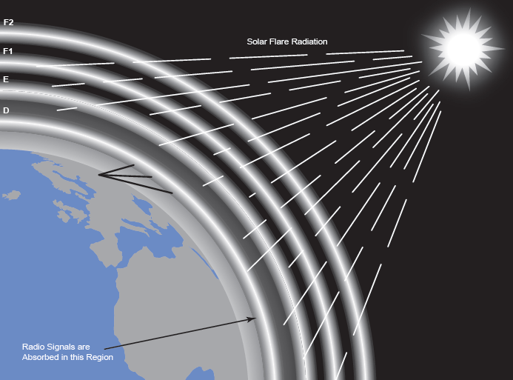
Solar Disturbances
Figure 8.7 — Approximately eight minutes after a solar flare occurs on the sun, the ultraviolet and X-ray radiation released by the flare reaches the Earth. This radiation causes increased ionization and radio wave absorption in the D region.

Slide 39
Solar Disturbances (cont.)
Solar flare: A large eruption of energy and solar material when magnetic field disruptions occur on the surface of the sun.
Coronal hole: A weak area in the sun’s corona (the outer layer) through which plasma (ionized gas and charged particles) escapes the sun’s magnetic field and streams away into space at high velocities.
Coronal mass ejection (CME): An ejection of large amounts of material from the corona.
All of these disrupt HF propagation

Slide 40
Sudden Ionospheric Disturbances
UV and X-ray radiation from a solar flare travels at speed of light to impact the ionosphere about 8 minutes later
When radiation hits the ionosphere, the level of ionization increases rapidly, particularly in D region
This increases absorption dramatically, causing a sudden ionospheric disturbance (SID) also known as a radio blackout
Lower bands are more strongly affected, but communication may still be possible on a higher band
SIDs affect only the sunlit side of the Earth; dark-side communications may be relatively unaffected

Slide 41
Geomagnetic Disturbances
Interaction between solar wind and geomagnetic field creates a region of space called the magnetosphere
Charged particles from coronal holes and coronal mass ejections travel considerably slower and take longer to reach Earth (15 to 40 hours)
These particles deposit their energy into Earth’s geomagnetic field and increase ionization in E region, causing auroral displays and creating a geomagnetic storm … affects higher HF bands first
Long-distance paths that traverse high latitudes, particularly those that pass near the magnetic poles, may be completely wiped out for hours to days
Can create auroras that reflect radio waves above 20 MHz
Auroral propagation is strongest on 6 and 2 m, modulating the signals with a hiss or buzz

Slide 42
PRACTICE QUESTIONS

Slide 43
What effect does a sudden ionospheric disturbance have on the daytime ionospheric propagation?
It enhances propagation on all HF frequencies
It disrupts signals on lower frequencies more than those on higher frequencies
It disrupts communications via satellite more than direct communications
None, because only areas on the night side of the Earth are affected
G3A02 (B) Page 8-12
43

Slide 44
Approximately how long does it take the increased ultraviolet and X-ray radiation from solar flares to affect radio propagation on Earth?
28 days
1 to 2 hours
8 minutes
20 to 40 hours
G3A03 (C) Page 8-11
44

Slide 45
What is a geomagnetic storm?
A sudden drop in the solar flux index
A thunderstorm that affects radio propagation
Ripples in the geomagnetic force
A temporary disturbance in Earth’s geomagnetic field
G3A06 (D) Page 8-12
45

Slide 46
How can a geomagnetic storm affect HF propagation?
Improve high-latitude HF propagation
Degrade ground wave propagation
Improve ground wave propagation
Degrade high-latitude HF propagation
G3A08 (D) Page 8-12
46

Slide 47
How can high geomagnetic activity benefit radio communications?
Creates auroras that can reflect VHF signals
Increases signal strength for HF signals passing through the polar regions
Improve HF long path propagation
Reduce long delayed echoes
G3A09 (A) Page 8-12
47

Slide 48
How long does it take a coronal mass ejection to affect radio propagation on Earth?
28 days
14 days
4 to 8 minutes
15 hours to several days
G3A11 (D) Page 8-12
48

Slide 49
How is long distance radio communication usually affected by the charged particles that reach Earth from solar coronal holes?
HF communication is improved
HF communication is disturbed
VHF/UHF ducting is improved
VHF/UHF ducting is disturbed
G3A14 (B) Page 8-12
49

Slide 50
What factors affect the MUF?
Path distance and location
Time of day and season
Solar radiation and ionospheric disturbances
All these choices are correct
G3B02 (D) Page 8-10
50

Slide 51
Which frequency will have the least attenuation for long-distance skip propagation?
Just below the MUF
Just above the LUF
Just below the critical frequency
Just above the critical frequency
G3B03 (A) Page 8-10
51

Slide 52
Which of the following is a way to determine current propagation on a desired band from your station?
Use a network of automated receiving stations on the internet to see where your transmissions are being received
Check the A-index
Send a series of dots and listen for echoes
All these choices are correct
G3B04 (A) Page 8-10
52

Slide 53
How does the ionosphere affect radio waves with frequencies below the MUF and above the LUF?
They are refracted back to Earth
They pass through the ionosphere
They are amplified by interaction with the ionosphere
They are refracted and trapped in the ionosphere to circle Earth
G3B05 (A) Page 8-10
53

Slide 54
What usually happens to radio waves with frequencies below the LUF?
They are refracted back to Earth
They pass through the ionosphere
They are attenuated before reaching the destination
They are refracted and trapped in the ionosphere to circle Earth
G3B06 (C) Page 8-10
54

Slide 55
What does LUF stand for?
The Lowest Usable Frequency for communications between two specific points
Lowest Usable Frequency for communications to any point outside a 100-mile radius
The Lowest Usable Frequency during a 24-hour period
Lowest Usable Frequency during the past 60 minutes
G3B07 (A) Page 8-10
55

Slide 56
What does MUF stand for?
The Minimum Usable Frequency for communications between two points
The Maximum Usable Frequency for communications between two points
The Minimum Usable Frequency during a 24-hour period
The Maximum Usable Frequency during a 24-hour period
G3B08 (B) Page 8-10
56

Slide 57
What happens to HF propagation when the LUF exceeds the MUF?
Propagation via ordinary skywave communications is not possible over that path
HF communications over the path are enhanced
Double-hop propagation along the path is more common
Propagation over the path on all HF frequencies is enhanced
G3B11 (A) Page 8-10
57

Slide 58
Section 8.3: Scatter Modes Scatter Characteristics
Backscatter: Reflections from features on Earth’s surface
Waves can also be scattered from within the ionosphere, allowing signals to be heard from stations too distant to be heard by ground wave and on frequencies too high for short hop sky-wave propagation
Scatter and backscatter help fill in the skip zone where signals would otherwise not be heard
Signals received via HF scatter are usually weaker than those received by normal skywave propagation (reflection is not very efficient and tends to spread out the signal); such signals sound distorted, resulting in fluttering or wavering

Slide 59
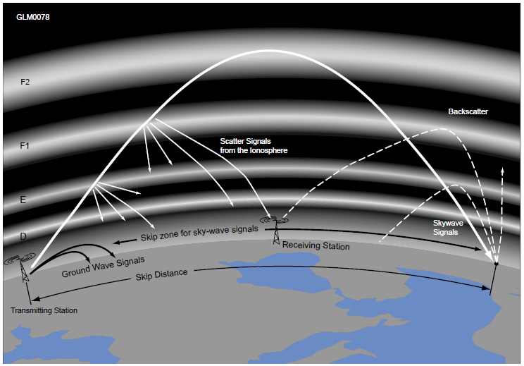
Fig 8.8
Scatter and Backscatter
On striking the ground after ionospheric reflection, radio waves may be reflected back toward the transmitting station. Backscatter consists of signals reflected by the ground back into the skip zone. Backscatter supports communication between stations that would otherwise be in each other’s skip zone.

Slide 60
Near Vertical Incidence Sky-wave (NVIS)
For a signal below the critical frequency, the ionosphere reflects waves arriving at any angle — even vertical (always above 5 MHz, up to 40 meters)
NVIS Definition: For a signal below the critical frequency, when it is radiated vertically the reflection scatters the signal back to Earth throughout a region of up to 200-300 miles
To make use of NVIS, horizontally polarized dipoles are placed low to the ground so that their radiation pattern is almost omnidirectional and concentrated at high elevation angles

Slide 61
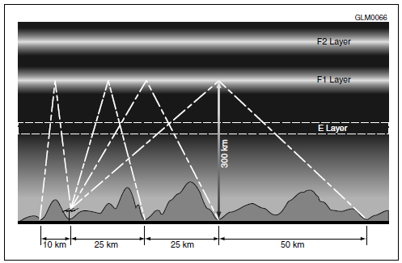
Fig 8.9
NVIS Communications
Near vertical incidence sky-wave (NVIS) communications relies on signals below the critical frequency transmitted at high vertical angles. The signals are reflected by the ionosphere back to Earth in the region around the transmitter.

Slide 62
PRACTICE QUESTIONS

Slide 63
What is a characteristic of HF scatter?
Phone signals have high intelligibility
Signals have a fluttering sound
There are very large, sudden swings in signal strength
Scatter propagation occurs only at night
G3C06 (B) Page 8-14
63

Slide 64
What makes HF scatter signals often sound distorted?
The ionospheric region involved is unstable
Ground waves are absorbing much of the signal
The E region is not present
Energy is scattered into the skip zone through several different paths
G3C07 (D) Page 8-14
64

Slide 65
Why are HF scatter signals in the skip zone usually weak?
Only a small part of the signal energy is scattered into the skip zone
Signals are scattered from the magnetosphere, which is not a good reflector
Propagation is via ground waves, which absorb most of the signal energy
Propagation is via ducts in the F region, which absorb most of the energy
G3C08 (A) Page 8-14
65

Slide 66
What type of propagation allows signals to be heard in the transmitting station’s skip zone?
Faraday rotation
Scatter
Chordal hop
Short-path
G3C09 (B) Page 8-14
66

Slide 67
What is near vertical incidence skywave (NVIS) propagation?
Propagation near the MUF
Short distance MF or HF propagation using high elevation angles
Long path HF propagation at sunrise and sunset
Double hop propagation near the LUF
G3C10 (B) Page 8-14
67

Slide 68
END OF CHAPTER 8 PART 1 OF 1

Slide 69
Slides created by …
Jerry D. Kilpatrick
KØILP (Amateur Radio)
PGØØØ72373 (Commercial Operator)
K0ILP.NC@gmail.com
Feel free to contact me if you find errors or have suggestions for improvement.

