Slide 1
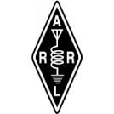

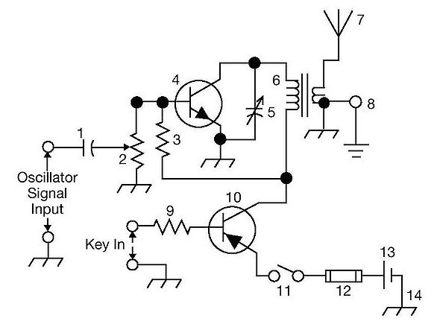
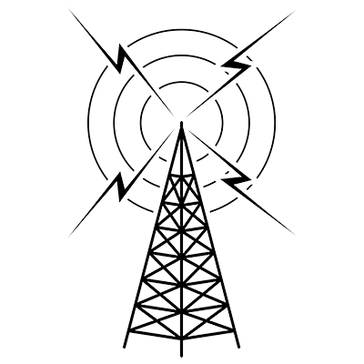
THE
ARRL
TENTH EDITION
GENERAL CLASS
LICENSE COURSE
FOR
HAM RADIO
All You Need to Pass Your General Class Exam!

Slide 2


Resource & Reference
www.arrl.org/shop/Licensing-Education-and-Training

Slide 3
Chapter 7 Part 2 of 2 ARRL General Class Antennas Sections 7.3, 7.4, 7.5 Loop Antennas, Specialized Antennas, Feed Lines

Slide 4
Section 7.3 Loop Antennas
Can be circular, square, triangular or any simple open shape that is not too narrow
Feed line can be attached at a break in the loop or a smaller loop can be used to couple RF energy to the main loop
A square loop with each leg 1⁄4 wavelength long is a quad loop
Triangular or delta loops are usually symmetrical, each leg 1⁄3 wavelength long
A one-wavelength loop acts electrically like two dipoles connected end-to-end with the open ends brought together
Circumference much larger than 1 λ, current patterns around loop have more than 2 peaks and nulls … result is an essentially omnidirectional pattern with the peak angle of radiation somewhat lower than a dipole at the same height

Slide 5
Quad and Delta Loop Beams
Popular variation of the Yagi beam uses quad loops for elements (quad)
Has two or more full-sized loops mounted on a boom
Quad or delta loop beam driven elements are approximately 1 λ in circumference and operate on the same principles of re-radiation and phase shift as does the Yagi
The driven element of a quad is about 1⁄4 λ per side and of a symmetrical delta loop about 1⁄3 λ per side
Quad and delta loop reflectors are about 5% longer in circumference than the driven element, and the directors about 5% shorter
Front-to-back ratio is generally better for the Yagi

Slide 6
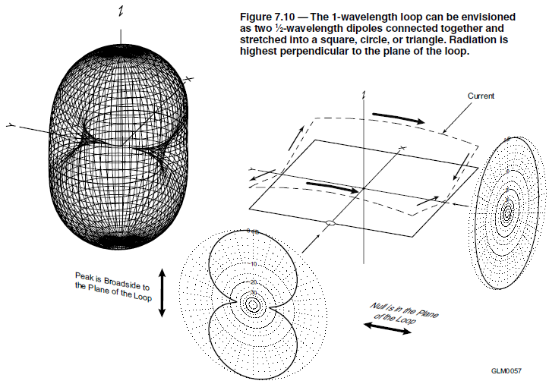
Fig. 7.10 1-Wavelength Loop Antenna
Direction of maximum signal is broadside to the plane of the loop, whether round, quad or delta. Orienting the loop vertically aims the maximum signal toward the horizon (good for DX).

Slide 7
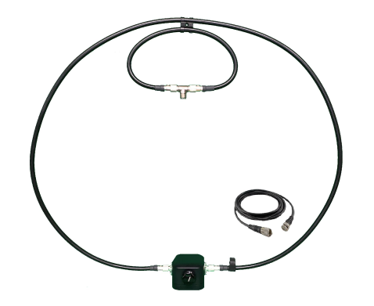
Small Loops
When the circumference of the loop becomes less than 1⁄3 λ, the current in the loop becomes relatively uniform all the way around the loop
Image in Fig. 7-10 a small loop rotated 90 degrees from the loop in the figure
Causes radiation pattern to develop sharp nulls broadside to the plane of the loop
In wide use as receiving antennas and portable or low-profile transmitting antennas
The sharp null broadside to the loop makes them effective for direction-finding
Typical small loop portable HF antenna

Slide 8
Halo Antennas
Dipole bent into a circle or square (the “squalo”) with the ends separated by a small gap
Not a continuous loop, but often viewed as a 1⁄2 λ loop
Usually mounted horizontally so they produce an omnidirectional pattern with the horizontal polarization preferred for VHF weak-signal operation
Halos for 6 and 2 meters can be mounted on a vehicle for mobile operation

Slide 9
PRACTICE QUESTIONS

Slide 10
In which direction is the maximum radiation from a VHF/UHF “halo” antenna?
Broadside to the plane of the halo
Opposite the feed point
Omnidirectional in the plane of the halo
On the same side as the feed point
G9D03 (C) Page 7-16
10

Slide 11
In which direction or directions does an electrically small loop (less than 1⁄10 wavelength in circumference) have nulls in its radiation pattern?
In the plane of the loop
Broadside to the loop
Broadside and in the plane of the loop
Electrically small loops are omnidirectional
G9D10 (B) Page 7-15
11

Slide 12
Section 7.4: Specialized Antennas Random Wire Antennas
Not always practical to have a 1⁄2 or 1⁄4 λ long resonant antenna (portable)
A random wire antenna can be used
Connected directly to the output of the transmitter (or tuner) without a feed line
May result in significant RF currents and voltages on the station equipment (RF burns)
Can give excellent results on any band for which the transmitter or tuner can accept the feed point impedance

Slide 13
Stacked Antennas
Stacking antennas (vertically or horizontally) results in more gain (see Fig 7.14)
As more and more directors are added, the beamwidth of the main lobe (angle between points on the main lobe at which gain is 3 dB less than maximum) narrows
Vertically stacking antennas increases gain and narrows the elevation beamwidth
Most vertical stacks, with the antennas directly above each other, space the antennas about λ/2 apart. Spaced λ/2 apart, the additional gain for a vertical stack of two horizontally-polarized beams is about 3 dB.

Slide 14
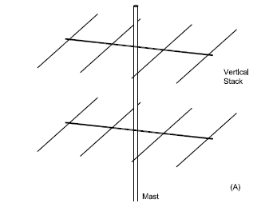
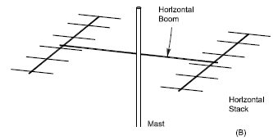
Fig. 7.14: Stacked Antennas
Stacking antennas produces more gain in a main lobe that is carefully controlled. At A, two Yagis are stacked vertically on the same mast.

Slide 15
Log Periodic Antennas (or Logs) … See Fig. 7.15
TV antennas are often log periodics
“Log” refers to logarithmic & periodic means the spacing of the elements along the boom
The length and the spacing of the elements increases logarithmically from one end to the other
Designed to have a consistent radiation pattern and low SWR over a wide frequency bandwidth (as much as 10:1)
Meaning the log periodic can be used over several bands
Not as much gain or front-to-back ratio as a Yagi antenna

Slide 16
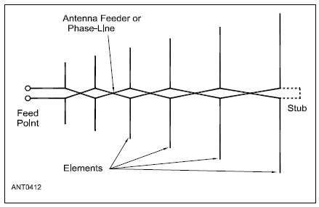
Fig. 7.15: Log Periodic Antenna
The log periodic dipole array (LPDA) consists of dipoles fed by a common feed line that alternates polarity between elements. Traditional TV
antennas sweep the elements slightly forward.

Slide 17
Beverage Antennas
Invented by Harold Beverage (see Fig 7.16)
Designed not to have high gain, but to reject noise and interfering signals that are not from the desired direction
Result is lower signal strength but a better signal-to-noise ratio
Referred to as a traveling wave antenna
Consists of a long, low wire (usually less than 20 feet high) aligned with the preferred signal direction
Used exclusively for directional receiving on MF and lower HF bands (40 meters and longer wavelengths)
Has high ground losses and is too inefficient for use as a transmitting antenna

Slide 18
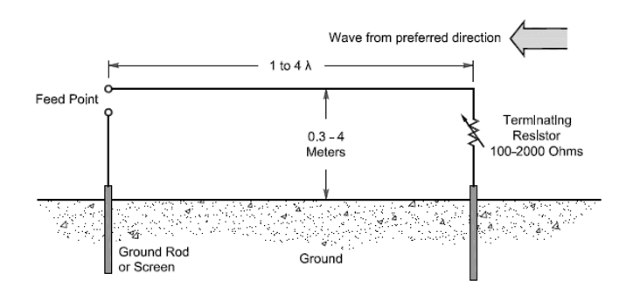
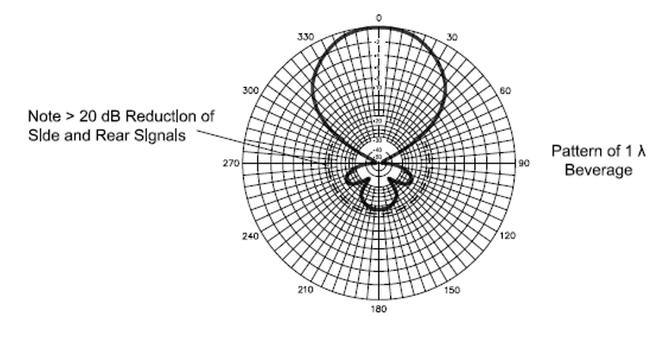
Fig. 7.16: Beverage Antenna
Antenna Design
Radiation Pattern
Signals arriving from the direction of the terminating resistor induce a traveling voltage wave along the wire transferred to the feed line at the feed point. Signals arriving from other directions are either absorbed by the terminating resistor or do not induce voltage waves in the antenna.

Slide 19
Multiband Antennas
What hams generally mean by multiband antenna is a design that reconfigures itself electrically for each band of operation
Most basic multiband antenna … trap dipole (See Fig 7.17)
Each trap is a parallel LC circuit
At resonance acts like an open circuit, below resonance like an inductor, and above resonance like a capacitor
At lower frequencies, the traps add inductance to the antenna, making the antenna look electrically longer
At higher frequencies, the capacitance electrically shortens the antenna

Slide 20
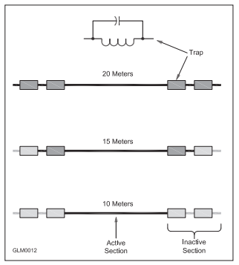
Fig 7.17: Traps
Traps are parallel LC circuits. They may be made from discrete inductors and capacitors or may use coaxial cable or metal sleeves.
The traps act like open circuits at their resonant frequency, causing different sections of the antenna to be active on different bands. This drawing shows a trap antenna that works on 10, 15, and 20 meters.

Slide 21
Trap Dipoles (cont.)
The lowest frequency of operation the antenna acts like a regular dipole, shortened by the inductance of the trap
Yagis can also use traps to work on several bands
3-element tribander Yagi with traps in the elements works well on 20, 15 & 10 meters
Trap drawbacks
Because it works on multiple bands, it radiates harmonics and spurious signals (transmitter operator’s responsibility to be sure those signals are not generated)
Trap losses reduce the efficiency of the antenna
Will not radiate as well as a full-sized antenna

Slide 22
PRACTICE QUESTIONS

Slide 23
What is a characteristic of a random-wire HF antenna connected directly to the transmitter?
It must be longer than 1 wavelength
Station equipment may carry significant RF current
It produces only vertically polarized radiation
It is more effective on the lower HF bands than on the higher bands
G9B01 (B) Page 7-16
23

Slide 24
In free space, how does the gain of two three-element, horizontally polarized Yagi antennas spaced vertically 1⁄2 wavelength apart typically compare to the gain of a single three-element Yagi?
Approximately 1.5 dB higher
Approximately 3 dB higher
Approximately 6 dB higher
Approximately 9 dB higher
G9C09 (B) Page 7-17
24

Slide 25
What is the primary function of antenna traps?
To enable multiband operation
To notch spurious frequencies
To provide balanced feed point impedance
To prevent out-of-band operation
G9D04 (A) Page 7-19
25

Slide 26
What is an advantage of vertical stacking of horizontally polarized Yagi antennas?
It allows quick selection of vertical or horizontal polarization
It allows simultaneous vertical and horizontal polarization
It narrows the main lobe in azimuth
It narrows the main lobe in elevation
G9D05 (D) Page 7-17
26

Slide 27
Which of the following is an advantage of a log periodic antenna?
Wide bandwidth
Higher gain per element than a Yagi antenna
Harmonic suppression
Polarization diversity
G9D06 (A) Page 7-17
27

Slide 28
Which of the following describes a log-periodic antenna?
Element length and spacing vary logarithmically along the boom
Impedance varies periodically as a function of frequency
Gain varies logarithmically as a function of frequency
SWR varies periodically as a function of boom length
G9D07 (A) Page 7-17
28

Slide 29
What is the primary use of a Beverage antenna?
Directional receiving for low HF bands
Directional transmitting for low HF bands
Portable direction finding at higher HF frequencies
Portable direction finding at lower HF frequencies
G9D09 (A) Page 7-19
29

Slide 30
Which of the following is a disadvantage of multiband antennas?
They present low impedance on all design frequencies
They must be used with an antenna tuner
They must be fed with open wire line
They have poor harmonic rejection
G9D11 (D) Page 7-19
30

Slide 31
Section 7.5 Feed Lines / Characteristic Impedance
Balanced feed lines consist of two parallel conductors separated by insulating material in the form of strips or spacers
Have different characteristic impedances (Z₀) that characterize how electromagnetic energy is carried by the feed line (different from resistance)
For parallel-conductor feed lines, the radius of the conductors and the distance between them determine Z₀
Most common type is window line
Typical impedance for window line is 450 Ω (some as low as 400 Ω)
Most common characteristic impedances for coaxial feed lines used by amateurs are 50 Ω and 75 Ω

Slide 32
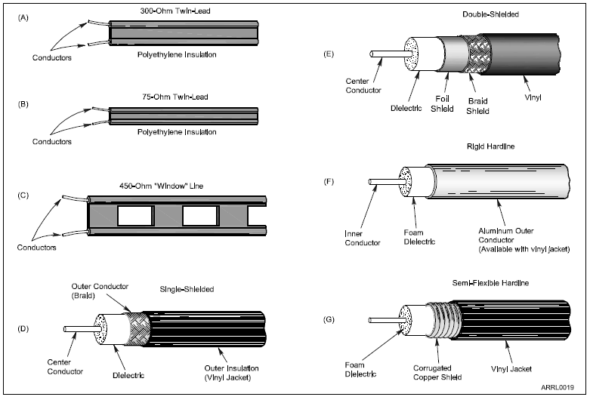
Fig 7.18
Some common types feed lines used by amateurs. Parallel conductor line (A, B, C) has two parallel conductors separated by insulation (dielectric). Coaxial cable (D, E, F, G) or “coax” has a center conductor surrounded by insulation. The center conductor may be made from stranded or solid wire. The second conductor, called the shield, covers the insulation and is in turn covered by the plastic outer jacket. The shield may be made from braid, or from solid aluminum or copper.

Slide 33
Forward & Reflected Power & SWR
A feed line transfers all of its power to an antenna when the antenna and feed line impedances are matched
If impedances don’t match, some of the power is reflected by antenna
Forward power: power traveling toward the antenna
Reflected power: power reflected by the antenna
Power in a feed line is reflected at any point at which the impedance of the feed line changes
Can be at an antenna, connector, or from a different type of feed line

Slide 34
SWR
The waves carrying forward power and reflected power form stationary patterns inside the feed line. These are called STANDING waves.
The ratio of the peak voltage in the standing wave to the minimum voltage is called the standing wave ratio (SWR)
Measures how well antenna and feed line impedances are matched
1:1 is a perfect match … none of the power is reflected
SWR = infinity (∞) indicates that all the power was reflected
SWR is always greater than 1:1 (for example, 3:1 and not 1:3)

Slide 35
Calculating SWR
SWR is equal to the ratio of the higher of antenna feed point impedance or feed line characteristic impedance to the lower.
Example: What is the SWR in a 50-Ω feed line connected to a 200-Ω load?
$$SWR= \frac{200}{50} =4= 4 :1$$
Example: What is the SWR in a 50-Ω feed line connected to a 10-Ω load?
$$SWR= \frac{50}{10} =5=5 :1$$

Slide 36
SWR (cont.)
Can be measured anywhere along feed line
Most commonly measured at connection to transmitter
SWR is measured by an SWR Meter (also called Bridge)
Transmitting equipment is designed to work at full power with an SWR at the input to the feed line of 2:1 or lower
Antennas that are much too short or too long will not work well and will have extreme feed point impedances, causing high SWR

Slide 37
Impedance Matching
Matching feed line and load (antenna) impedances eliminates standing waves from reflected power and maximizes power delivered to the load (but, not always practical … the impedance matching is more often done at the transmitter end of the feed line)
Devices used to reduce SWR are called: impedance matcher, transmatch, antenna coupler, and antenna tuner
Tuners do NOT tune the antenna at all — only changes impedance of the antenna system at end of feed line to match that of transmitter
In other words, an antenna tuner increases the power transfer from the transmitter to the feed line

Slide 38
Impedance Matching (cont.)
Devices constructed from inductors and capacitors that are adjustable by the operator
T circuit can match a wide range of impedances at the feed line connection to 50 Ω that matches transmitter output impedance
It is important to remember that the SWR in the feed line between the impedance matching device and the antenna does not change … the device just changes the load going to the transmitter … SWR in feed line stays the same

Slide 39
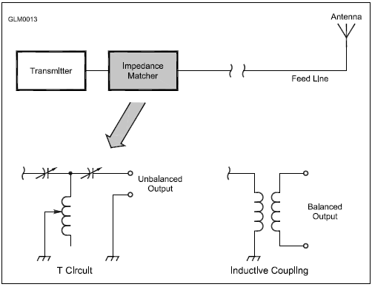
Fig. 7.19: T Network
Installed at the transmitter end of the feed line, a T network is designed to be used with unbalanced, coaxial feed lines. This circuit uses two variable capacitors and one variable inductor. To use balanced feed lines, such as window line, the output of a T network can be inductively coupled to the output so that neither of the feed line conductors is connected to ground.

Slide 40
Feed Line Loss
Feed lines dissipate a little of the energy they carry as heat (called attenuation or loss)
Loss is measured in dB per unit of length, usually dB/100 feet
Loss increases with frequency for all types of feed lines
The smaller the cable diameter, the higher the loss
Increasing SWR in a feed line also increases the total loss
The higher the feed line loss, the lower the measured SWR will be at the input to the line

Slide 41
PRACTICE QUESTIONS

Slide 42
What is the purpose of an antenna tuner?
Reduce the SWR in the feed line to the antenna
Reduce the power dissipation in the feedline to the antenna
Increase power transfer from the transmitter to the feed line
All these choices are correct
G4A06 (C) Page 7-22
42

Slide 43
Which of the following factors determine the characteristic impedance of a parallel conductor feed line?
The distance between the centers of the conductors and the radius of the conductors
The distance between the centers of the conductors and the length of the line
The radius of the conductors and the frequency of the signal
The frequency of the signal and the length of the line
G9A01 (A) Page 7-20
43

Slide 44
What is the relationship between high standing wave ratio (SWR) and transmission line loss?
There is no relationship between transmission line loss and SWR
High SWR increases loss in a lossy transmission line
High SWR makes it difficult to measure transmission line loss
High SWR reduces the relative effect of transmission line loss
G9A02 (B) Page 7-23
44

Slide 45
What is the nominal characteristic impedance of “window line” transmission line?
50 ohms
75 ohms
100 ohms
450 ohms
G9A03 (D) Page 7-21
45

Slide 46
What causes reflected power at an antenna’s feed point?
Operating an antenna at its resonant frequency
Using more transmitter power than the antenna can handle
A difference between feed-line impedance and antenna feed-point impedance
Feeding the antenna with unbalanced feed line
G9A04 (C) Page 7-21
46

Slide 47
How does the attenuation of coaxial cable change with increasing frequency?
Attenuation is independent of frequency
Attenuation increases
Attenuation decreases
Attenuation follows Marconi’s Law of Attenuation
G9A05 (B) Page 7-23
47

Slide 48
In what units is RF feed line loss usually expressed?
Ohms per 1,000 feet
Decibels per 1,000 feet
Ohms per 100 feet
Decibels per 100 feet
G9A06 (D) Page 7-23
48

Slide 49
What must be done to prevent standing waves on a feed line connected to an antenna?
The antenna feed point must be at DC ground potential
The feed line must be an odd number of electrical quarter wavelengths long
The feed line must be an even number of physical half wavelengths long
The antenna feed point impedance must be matched to the characteristic impedance of the feed line
G9A07 (D) Page 7-22
49

Slide 50
If the SWR on an antenna feed line is 5:1, and a matching network at the transmitter end of the feed line is adjusted to present a 1:1 SWR to the transmitter, what is the resulting SWR on the feed line?
1 to 1
5 to 1
Between 1 to 1 and 5 to 1 depending on the characteristic impedance of the line
Between 1 to 1 and 5 to 1 depending on the reflected power at the transmitter
G9A08 (B) Page 7-23
50

Slide 51
What standing wave ratio results from connecting a 50-ohm feed line to a 200-ohm resistive load?
4:1
1:4
2:1
1:2
G9A09 (A) Page 7-22
51

Slide 52
What standing wave ratio results from connecting a 50-ohm feed line to a 10-ohm resistive load?
2:1
1:2
1:5
5:1
G9A10 (D) Page 7-22
52

Slide 53
END OF CHAPTER 7 PART 2 OF 2

Slide 54
Slides created by …
Jerry D. Kilpatrick
KØILP (Amateur Radio)
PGØØØ72373 (Commercial Operator)
K0ILP.NC@gmail.com
Feel free to contact me if you find errors or have suggestions for improvement.

