Slide 1
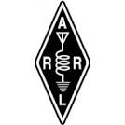

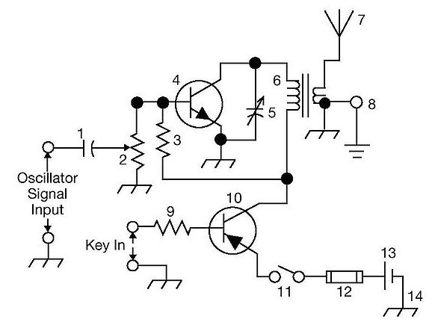
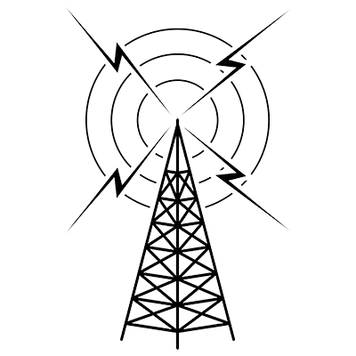
THE
ARRL
TENTH EDITION
GENERAL CLASS
LICENSE COURSE
FOR
HAM RADIO
All You Need to Pass Your General Class Exam!

Slide 2
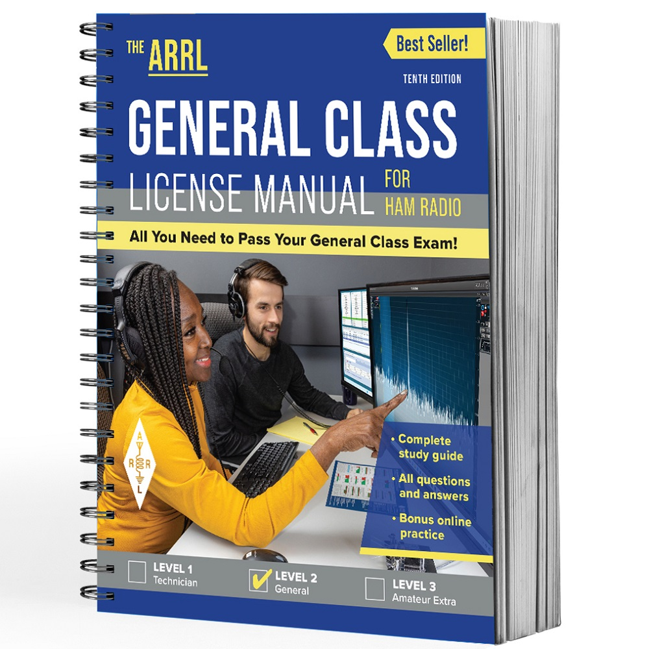
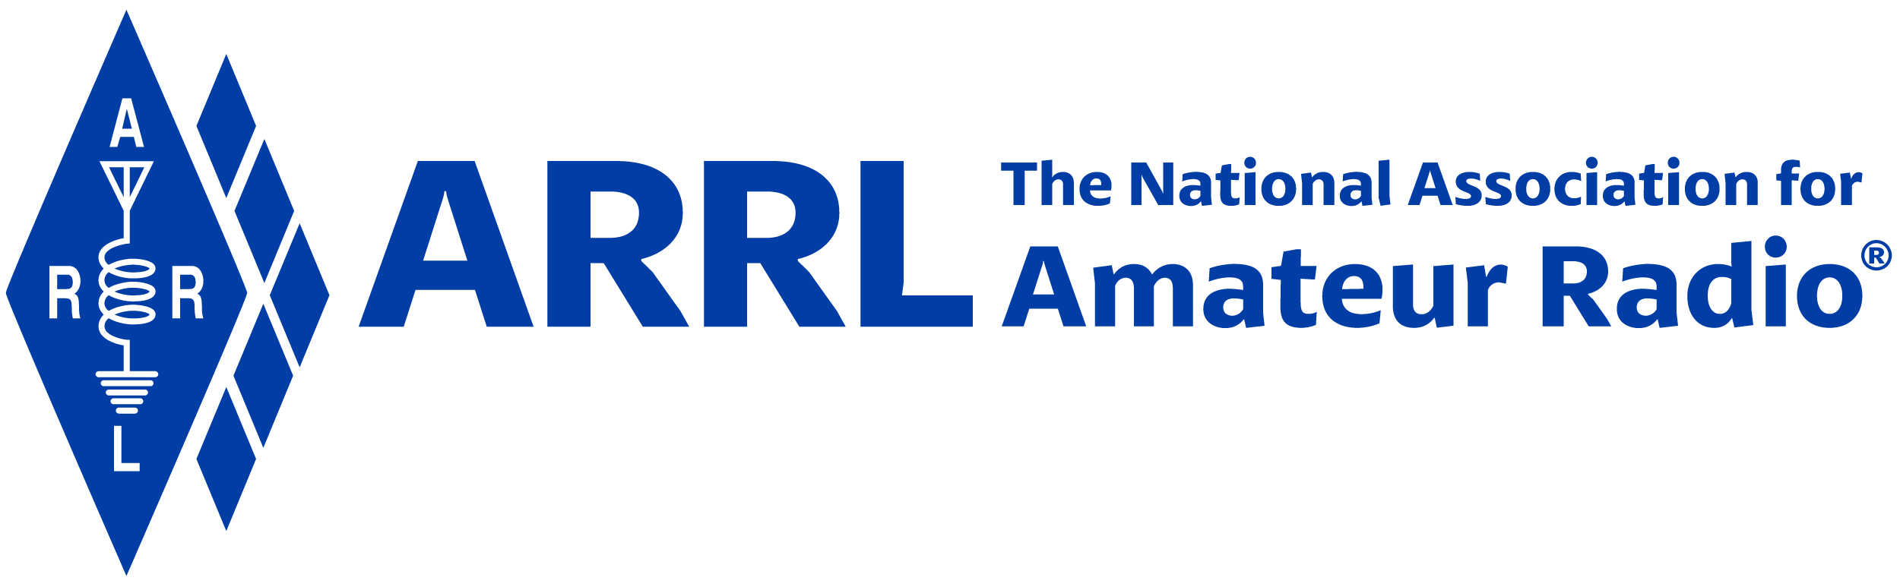
Resource & Reference
www.arrl.org/shop/Licensing-Education-and-Training

Slide 3
Chapter 4 Part 2 of 3
ARRL General Class
Components and Circuits
Sections 4.4, 4.5
Reactance, Impedance & Resonance, Active Components

Slide 4
Section 4.4
Reactance
Reactance: Resistance to the flow of ac current caused by capacitance or inductance. Denoted by X. Measured in ohms (Ω), like resistance.
Capacitive Reactance: Opposition to ac current flow from the stored energy in a capacitor. Denoted by X_{C} (see next slide).
Capacitors behave differently with ac and dc current. With dc, when voltage is initially applied, capacitor looks like a short circuit. After charging, it looks like an open circuit. This is how it blocks dc signals. AC behavior depends upon voltage frequency.

Slide 5
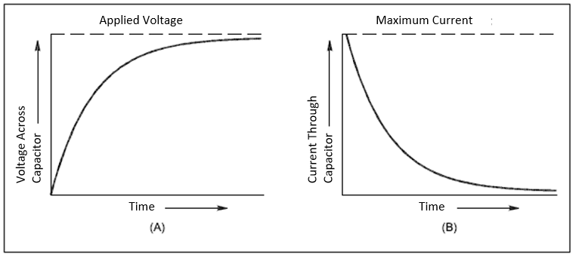
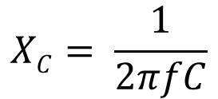
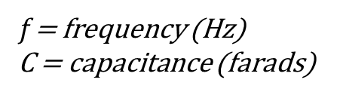
Capacitive Reactance
As the frequency (f) of the applied signal increases, X_{C} decreases, and vice versa.
When a circuit containing a capacitor is first energized, the voltage across the capacitor is zero and the current is very large. As time passes, the voltage across the capacitor increases, as shown at A, and the current drops toward zero, as shown at B.

Slide 6
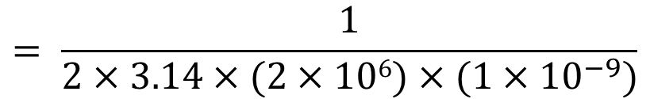
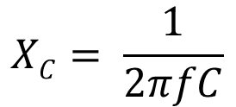

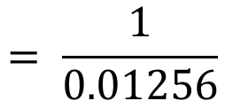
Capacitive Reactance (cont.)
Example: What is the reactance of a 1 nF capacitor at 2 MHz?
First convert MHz to Hz and nF to F … (everything in base units)
2 MHz = 2,000,000 Hz = 2 × 10⁶ Hz
1 nF = 1/1,000,000,000 F = 1 × 10^{–9} F
$$XC= \frac{1}{2πfC}$$
$$= \frac{1}{2×3.14×(2×106)×(1×{10}^{−9})}$$
$$= \frac{1}{0.01256}$$
$$=79.6 Ω$$

Slide 7

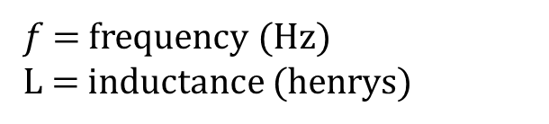
Reactance (cont.)
Inductive Reactance is the opposition to ac current flow from the stored energy in a inductor and is denoted by X_{L}
Behavior with frequency is described by:

Slide 8
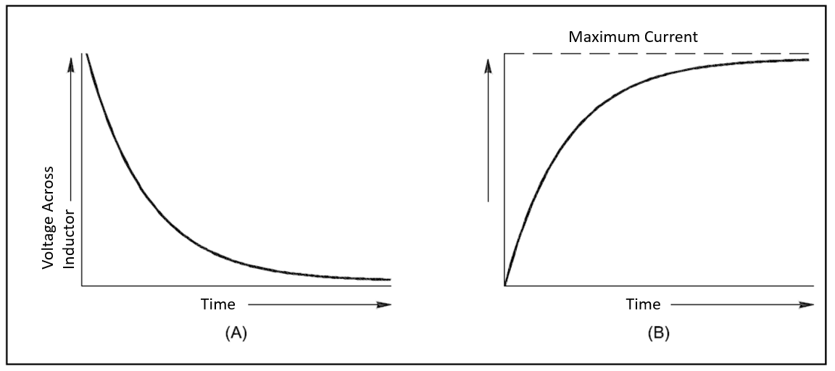
Inductive Reactance
As the frequency (f) of the applied signal increases, X_{L} increases, and vice versa
When a circuit containing an inductor is first energized the initial current is zero and the full applied voltage appears across the inductor. As time passes, the voltage drops toward zero as shown at A, and the current increases, as shown at B.

Slide 9
Inductive Reactance (cont.)
Example: What is the reactance of a 10 μH inductor at 5 MHz?
First convert μH to H and MHz to Hz (everything to same base units)
5 MHz = 5,000,000 Hz = 5 × 10⁶ Hz
10 μH = 10/1,000,000 H = 1 × 10^{–5} H
$$XL=2πfL=2×3.14×\left(5×{10}^{6}\right)×\left(1×{10}^{−5}\right)=314 Ω$$

Slide 10
Parasitic Inductance
Parasitic: an unwanted characteristic resulting from the component’s physical construction. Examples:
  The coils in wire-wound resistors (coils create parasitic inductance)
  Wire leads of components
  In inductors, each pair of turns creates parasitic capacitance in series with the inductance
Often significant enough to disrupt circuit’s operation or affect tuning in radios

Slide 11
Parasitic Inductance (cont.)
Some capacitors made of thin foils are rolled up – the rolled up construction creates parasitic inductance – very high in electrolytic capacitors
  This limits their use to relatively low frequencies
Tantalum and ceramic capacitors have little parasitic inductance – can be used up to microwave frequencies

Slide 12
PRACTICE QUESTIONS

Slide 13
What is reactance?
Opposition to the flow of direct current caused by resistance
Opposition to the flow of alternating current caused by capacitance or inductance
Reinforcement of the flow of direct current caused by resistance
Reinforcement of the flow of alternating current caused by capacitance or inductance
G5A02 (B) Page 4-20
13

Slide 14
Which of the following causes opposition to the flow of alternating current in an inductor?
Conductance
Reluctance
Admittance
Reactance
G5A03 (D) Page 4-20
14

Slide 15
Which of the following causes opposition to the flow of alternating current in a capacitor?
Conductance
Reluctance
Reactance
Admittance
G5A04 (C) Page 4-20
15

Slide 16
How does an inductor react to AC?
As the frequency of the applied AC increases, the reactance decreases
As the amplitude of the applied AC increases, the reactance increases
As the amplitude of the applied AC increases, the reactance decreases
As the frequency of the applied AC increases, the reactance increases
G5A05 (D) Page 4-22
16

Slide 17
How does a capacitor react to AC?
As the frequency of the applied AC increases, the reactance decreases
As the frequency of the applied AC increases, the reactance increases
As the amplitude of the applied AC increases, the reactance increases
As the amplitude of the applied AC increases, the reactance decreases
G5A06 (A) Page 4-21
17

Slide 18
What unit is used to measure reactance?
Farad
Ohm
Ampere
Siemens
G5A09 (B) Page 4-20
18

Slide 19
Why should wire-wound resistors not be used in RF circuits?
The resistor’s tolerance value would not be adequate
The resistor’s inductance could make circuit performance unpredictable
The resistor could overheat
The resistor’s internal capacitance would detune the circuit
G6A06 (B) Page 4-22
19

Slide 20
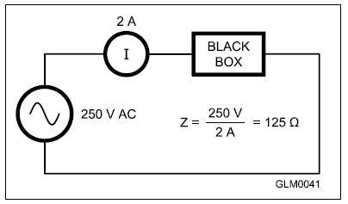
Impedance
Figure 4.13
Current as measured
Impedance is the opposition to current flow in an ac circuit caused by resistance, reactance, or any combination of the two. Denoted by Z. Measured in ohms.
Like resistance, it’s the ratio of voltage to current (Fig. 4.13).
The inverse of impedance is admittance
Applied voltage

Slide 21
Resonance
Resonance indicates a match between the frequency at which a circuit or antenna naturally responds to the frequency of an applied signal
Occurs when … capacitive reactance = inductive reactance
In a resonant series circuit, reactance of L and C cancel, making a short circuit, leaving only the resistance (R) as the circuit’s impedance
Used in filters & tuned circuits to pass or reject specific frequencies

Slide 22
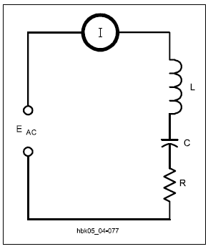
Resonant Series Circuit
In a resonant series circuit, the reactance of L and the reactance of C cancel, making a short circuit. This leaves only the resistance (R) as the circuit’s impedance.

Slide 23
Self-Resonance
Resonance can occur when a component’s expected reactance equals the reactance of it’s parasitic reactance (called self-resonance)
Results in a component that appears to be a short or open circuit at the self-resonant frequency
Above this frequency, the component’s reactance switches type, making an inductor capacitive and a capacitor inductive!

Slide 24
Impedance Transformation
A transformer can change the combination of voltage and current while transferring energy
The transformer also changes impedance between the primary and secondary circuits (by changing the ratio of voltage and current between the primary and secondary circuits)
The turns ratio controls the transformation in the same way as the ratio of gear teeth in a mechanical transmission

Slide 25
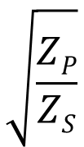
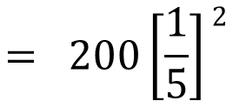

Impedance Transformation Examples
2
N_{P}
N_{P}
Z_{P} = Z_{S}
or
=
N_{S}
N_{S}
What is the primary impedance if a 200 Ω load is connected to the secondary of a transformer with a 5:1 secondary-to-primary turns ratio?
N_{P}
2
Z_{P} = Z_{S}
N_{S}

Slide 26
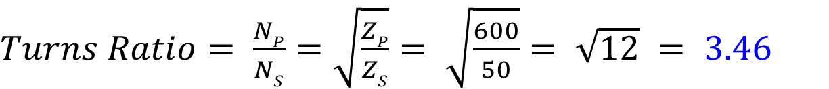
Impedance Transformation Examples (cont.)
What turns ratio is required to change a 600 Ω impedance to a 50 Ω impedance?
$Turns Ratio= \frac{NP}{NS}=$ $\sqrt{\frac{ZP}{ZS}}= \sqrt{\frac{600}{50}}= \sqrt{12} = 3.46$
Note that the impedance to be changed (in this case 600 Ω) can be connected to the primary or secondary, but turns ratios are always stated with the larger number first. (3.46:1 not 1:3.46)

Slide 27
Impedance Matching
An energy source’s ability to deliver power to a load is limited by its internal impedance
Amateur transmitting equipment is designed so that the internal impedance of its output circuits is 50 Ω
If the difference between the antenna system impedance and transmitter’s out impedance is great enough, the transmitter may reduce output power to avoid damage (solution is an impedance-matching circuit)

Slide 28
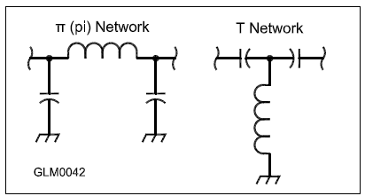
Impedance Matching (cont.)
Most impedance-matching circuits are LC circuits (inductors and capacitors), called π and T networks … see figure below:
Impedance matching can also be performed by special lengths and connections of transmission line.

Slide 29
PRACTICE QUESTIONS

Slide 30
What happens when inductive and capacitive reactance are equal in a series LC circuit?
Resonance causes impedance to be very high
Impedance is equal to the geometric mean of the inductance and capacitance
Resonance causes impedance to be very low
Impedance is equal to the arithmetic mean of the inductance and capacitance
G5A01 (C) Page 4-23
30

Slide 31
What is the term for the inverse of impedance?
Conductance
Susceptance
Reluctance
Admittance
G5A07 (D) Page 4-23
31

Slide 32
What is impedance?
The ratio of current to voltage
The product of current and voltage
The ratio of voltage to current
The product of current and reactance
G5A08 (C) Page 4-23
32

Slide 33
Which of the following devices can be used for impedance matching at radio frequencies?
A transformer
A Pi-network
A length of transmission line
All these choices are correct
G5A10 (D) Page 4-25
33

Slide 34
What letter is used to represent reactance?
Z
X
B
Y
G5A11 (B) Page 4-23
34

Slide 35
What occurs in an LC circuit at resonance?
Current and voltage are equal
Resistance is cancelled
The circuit radiates all its energy in the form of radio waves
Inductive reactance and capacitive reactance cancel
G5A12 (D) Page 4-24
35

Slide 36
What transformer turns ratio matches an antenna’s 600-ohm feed point impedance to a 50-ohm coaxial cable?
3.5 to 1
12 to 1
24 to 1
144 to 1
G5C07 (A) Page 4-24
36

Slide 37
What happens when an inductor is operated above its self-resonant frequency?
Its reactance increases
Harmonics are generated
It becomes capacitive
Catastrophic failure is likely
G6A11 (C) Page 4-24
37

Slide 38
What is one reason to use an impedance matching transformer at a transmitter output?
To minimize transmitter power output
To present the desired impedance to the transmitter and feed line
To reduce power supply ripple
To minimize radiation resistance
G7C03 (B) Page 4-25
38

Slide 39
Section 4.5
Semiconductor Components
The most common active components are made of semiconductors
Most are made of silicon and germanium
Electrical properties can be controlled by addition of small amounts of dopants (impurities) such as indium and phosphorus
If the impurity creates an excess of electrons, the result is an N-type material. The opposite is P-type (a deficit of electrons).
Where N-type and P-type are in contact is a PN junction

Slide 40
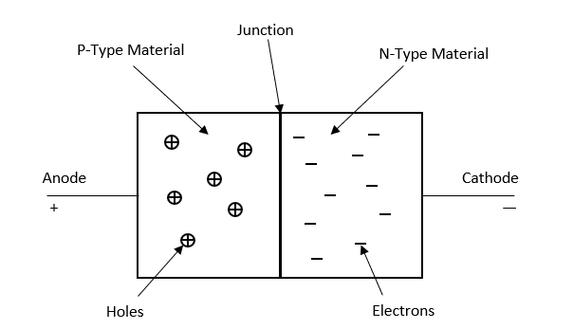
Diodes & Rectifiers
A semiconductor junction diode uses a PN junction to block current flow in one direction
Wire leads are attached to each layer
Current flows when positive voltage is applied from P-type to N-type material (forward bias)

Slide 41
Diodes & Rectifiers (cont.)
Voltage applied in opposite direction is reverse bias
  Pulls electrons away from junction so no current flows
Voltage required to force electrons across junction is the forward voltage or junction threshold voltage (V_{F})
  For silicon diodes, V_{F} ≅ 0.7 V
  For germanium diodes, V_{F} ≅ 0.3 V

Slide 42
Types of Diodes
Light Emitting
Laser
Avalanche
Zener
Schottky
Photodiode
PN junction
Transient Voltage Suppression
Gold Doped
Constant Current
Peltier
Silicon Controlled Rectifier
PIN
Varactor

Slide 43
Diode Ratings
Peak inverse voltage (PIV): Maximum reverse voltage before breakdown occurs (allowing current to flow in reverse direction)
Average forward current (I_{F}): Exceeding diode’s rating will destroy the diode’s internal structure
Junction capacitance (C_{J}): When reverse biased, layers of P- and N-type material act like capacitor plates. The larger the C_{J} the longer it takes to switch to conducting forward current.

Slide 44
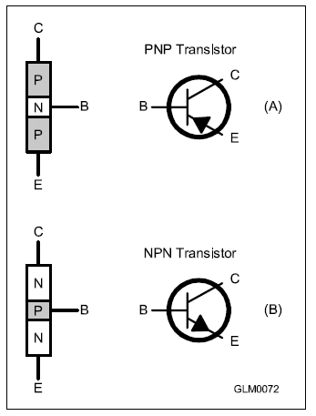
Bipolar Transistors
Adding a 3rd layer of semiconducting material creates a device that can amplify signals is called the transistor
Figure here is a bipolar junction transistor (BJT)
Requires power to function
3 electrodes
  Collector (C)
  Base (B)
  Emitter (E)
Controlled by current flow between base and emitter

Slide 45
Bipolar Transistors (cont.)
Very little base-emitter current is required for collector-emitter current to flow
The control of a large current by a smaller current is amplification
Ratio of collector-emitter current to base-emitter current is current gain
  Current gain for dc signals is ß
  Current gain for ac signals is h_{fe}

Slide 46
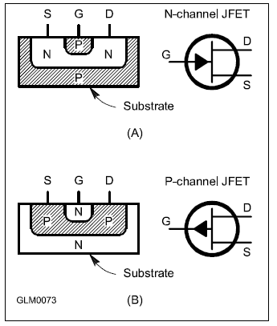
Field Effect Transistors (FET)
3 electrodes: Drain (D), Source (S), and Gate (G)
Instead of controlling drain-source current with gate-source current, the voltage between gate and source is used
Instead of current gain, FET has transconductance (g_{m}) which is the ratio of source-drain current to gate voltage
MOSFETs (metal-oxide semiconductor FET) use oxide layer to insulate the gate

Slide 47
Additional Transistor Notes
FETs are very sensitive … require only small amounts of voltage to control the source-drain current
High amplification makes them ideal for use as switches (both voltage and current)
With enough voltage, transistors can be driven into saturation where further increases in input result in NO change in output
High enough input signals can reduce output current to zero called cutoff
Saturation and cutoff conditions are excellent representation of digital ON/OFF signals in logic circuits

Slide 48
PRACTICE QUESTIONS

Slide 49
What is the approximate junction threshold voltage of a germanium diode?
0.1 volt
0.3 volts
0.7 volts
1.0 volts
G6A03 (B) Page 4-26
49

Slide 50
What is the approximate forward threshold voltage of a silicon junction diode?
0.1 volt
0.3 volts
0.7 volts
1.0 volts
G6A05 (C) Page 4-26
50

Slide 51
What are the operating points for a bipolar transistor used as a switch?
Saturation and cutoff
The active region (between cutoff and saturation)
Peak and valley current points
Enhancement and depletion modes
G6A07 (A) Page 4-27
51

Slide 52
Which of the following describes MOSFET construction?
The gate is formed by a back-biased junction
The gate is separated from the channel by a thin insulating layer
The source is separated from the drain by a thin insulating layer
The source is formed by depositing metal on silicon
G6A09 (B) Page 4-27
52

Slide 53
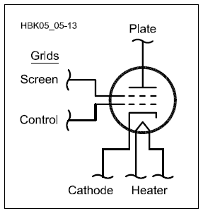
Vacuum Tubes
Have at least 3 electrodes called elements
3 basic parts:
  A source of electrons
  Electrode to collect electrons
  Intervening electrodes that control electrons traveling from source to collector
Compared to transistors, most like the FET
Operate at high (hazardous) voltages (2000-3000 V). Exercise caution!

Slide 54
Tube Terminology
Filament or heater – heats the cathode, causing it to emit electrons
Cathode – source of electrons
Control grid – grid closest to cathode, used to regulate electron travel between cathode and plate
Screen grid – electrode that reduces grid-to-plate capacitance
Suppressor grid – prevents electrons from traveling from plate to control or screen grid
Plate – collects electrons, called plate current

Slide 55
PRACTICE QUESTIONS

Slide 56
Which element of a vacuum tube regulates the flow of electrons between cathode and plate?
Control grid
Suppressor grid
Screen grid
Trigger electrode
G6A10 (A) Page 4-28
56

Slide 57
What is the primary purpose of a screen grid in a vacuum tube?
To reduce grid-to-plate capacitance
To increase efficiency
To increase the control grid resistance
To decrease plate resistance
G6A12 (A) Page 4-28
57

Slide 58
Analog Integrated Circuits (IC’s)
IC Definition: An electronic circuit formed on a small piece of semiconducting material, performing the same function as a larger circuit made from discrete components (aka, CHIP)
Operate over a continuous range of voltages and currents
Used for amplification, filtering, measurement, voltage regulation, and power control
Most common analog IC’s: operational amplifier and linear voltage regulator
  Op amps are used for dc and audio circuits … inexpensive source of gain
  Linear voltage regulators maintain power supply output at constant voltage over a wide range of currents

Slide 59
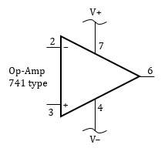

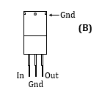
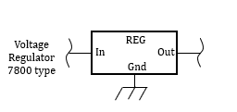
Figure 4.22
The popular 741 op-amp symbol and dual in-line package (DIP) connections are shown at (A). A common 3-terminal voltage regulator, the 7800-series, is shown in the TO-220 package at (B).

Slide 60
Digital Integrated Circuits
Digital IC’s operate with discrete values of voltage and current representing the binary numbers system values 0 and 1 (representing OFF and ON)
Used for performing computations or controlling functions
The most popular logic family in use is CMOS (complementary metal-oxide semiconductors) technology (known for high speed and low power consumption)

Slide 61
Table 4.4: Logic Family Characteristics
FAMILY NAME | MAX OPERATION FREQUENCY | POWER CONSUMPTION | POWER SUPPLY
TTL | 100 MHz | High | 5 V
CMOS | 1 GHz | Low | 3-5 V
CMOS (CD4000) | 1 MHz | Very Low | 3-15 V

Slide 62
Digital Logic Basics
The basic building block of digital circuits are called gates that perform inversion (changing 1 to 0 and vice versa) and the OR and AND functions
The most common gates in use are the inverter, NAND and NOR
More complex functions (e.g., microprocessors, signal processors, etc.) are constructed from combinations of these functions
Circuits that use gates to combine binary inputs to generate a binary output or combination of binary outputs are called combinational logic
See Figure 4.23 for details

Slide 63
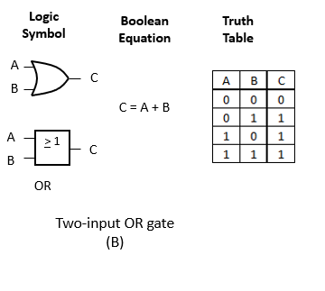
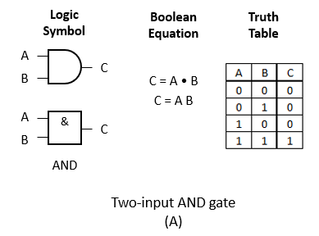
Figure 4.23: Schematic symbols for the basic digital logic functions with the logic equations and truth tables that describe their operation.

Slide 64
Reading TRUTH Tables
Can you think of examples where these might be used?
Refer to previous slide
Two-input AND gate
  If EITHER A or B are OFF, the gate is OFF
  Both have to be ON for the gate to be ON
Two-input OR gate
  If EITHER A or B are ON, the gate is ON
  Both have to be OFF for the gate to be OFF
AND: Gumball machine – need to insert coin AND press button to dispense.
OR: Intrusion detection – alarm sounds for intrusion at front door OR bedroom window.

Slide 65
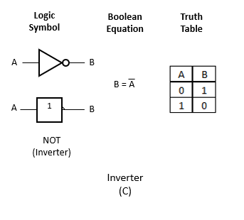
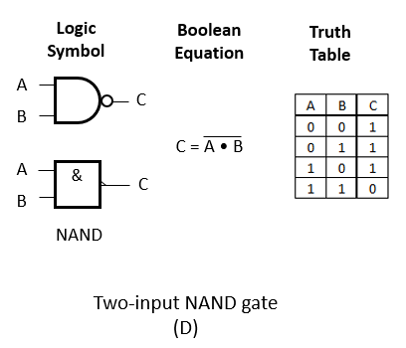
Figure 4.23: Schematic symbols for the basic digital logic functions with the logic equations and truth tables that describe their operation (cont.).

Slide 66
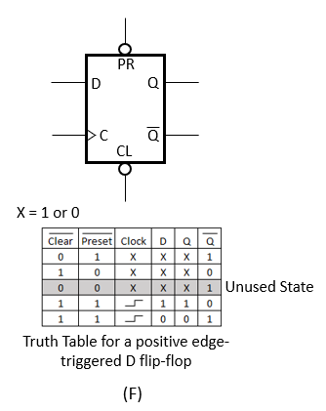
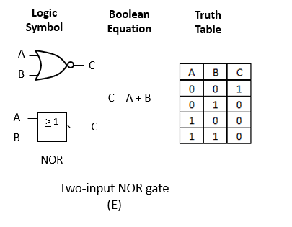
Figure 4.23: Schematic symbols for the basic digital logic functions with the logic equations and truth tables that describe their operation (cont.).

Slide 67
Digital Logic Basics (cont.)
Sequential logic circuits combine binary signals in a way that depends on time and on the sequence of inputs to the circuits
Basic building block of sequential logic is the flip-flop
  Responds to clock signal that causes it outputs to change based on input
  The 2 outputs (Q and Q-bar) are always in opposite states
  Connecting flip-flops together so that one flip-flop’s output feeds the next one’s input creates 2 important circuits; counters and shift registers

Slide 68
Counter Logic
The outputs of the chain of flip-flops make up a binary number or state representing the number of clock signals that have occurred
Each flip-flop stores one bit of the total count
Highest number a counter can represent is 2^{N} (N = number of flip-flops that make up the counter)
A 3-bit counter (3 flip-flops) can count 2³ (= 8) states, 4-bit (2⁴) can count 16 states, 5-bit (2⁵) counts 32 states, etc.

Slide 69
Shift Registers
Connecting the array of flip-flops slightly differently results in a shift register
  Stores a sequence of 1s and 0s from its input as the flip-flop outputs
  Each clock signal causes the value at the shift register’s input to pass or shift to the next flip-flop in the string
Some shift registers circuits can be configured to shift up and down (or forward/backward)
A simple form of digital memory

Slide 70
RF Integrated Circuits
Designed for functions such as …
  Low-level high-gain amplifiers, mixers, modulators/demodulators, filters
Greatly reduce number of discrete devices require to build radio circuits
Monolithic microwave integrated circuits (MMIC) are special types of RF IC’s that work through microwave frequencies
  Perform several functions
  Enables construction of low-cost cell phones, GPS receivers, etc.

Slide 71
PRACTICE QUESTIONS

Slide 72
What is meant by the term MMIC?
Multi-Mode Integrated Circuit
Monolithic Microwave Integrated Circuit
Metal Monolayer Integrated Circuit
Mode Modulated Integrated Circuit
G6B02 (B) Page 4-32
72

Slide 73
Which of the following is an advantage of CMOS integrated circuits compared to TTL integrated circuits?
Low power consumption
High power handling capability
Better suited for RF amplification
Better suited for power supply regulation
G6B03 (A) Page 4-30
73

Slide 74
What kind of device is an integrated circuit operational amplifier?
Digital
MMIC
Programmable Logic
Analog
G6B06 (D) Page 4-30
74

Slide 75
Which of the following describes the function of a two-input AND gate?
Output is high when either or both inputs are low
Output is high only when both inputs are high
Output is low when either or both inputs are high
Output is low only when both inputs are high
G7B03 (B) Page 4-30
75

Slide 76
How many states does a 3-bit binary counter have?
3
6
8
16
G7B05 (C) Page 4-31
76

Slide 77
What is a shift register?
A clocked array of circuits that passes data in steps along the array
An array of operational amplifiers used for tri-state arithmetic operations
A digital mixer
An analog mixer
G7B06 (A) Page 4-31
77

Slide 78
Microprocessors & Related Components: Memory
Microprocessors are microcontroller ICs that are capable of performing millions of computing instructions per second
Programs must be stored in memory devices so the microprocessor can read the instructions
  Volatile memory loses data when power is removed
  Nonvolatile memory stores data permanently, even without power
  Random-access memory (RAM) can be read from or written to
  Read-only memory (ROM) stores data permanently and cannot be changed

Slide 79

Data Interfaces
Microprocessors communicate through data interfaces
  Two types: Serial & Parallel
  Serial transfers one bit of data in each transfer operation
  Parallel transfers multiple bits in each operation
One BIT
One BYTE

Slide 80
Visual Interfaces
Amateur equipment uses two types of devices to present information visually; Indicators & displays
Indicators: Presents ON/OFF information visually by the presence or absence of color or light
  Common indicators: Incandescent light bulbs & light-emitting diodes (LEDs)
Displays: Presents text or graphics information in visual form

Slide 81
LEDs
Have largely replaced incandescent light bulbs in amateur equipment
  Last longer, can be turned on/off more quickly, use less power, generate less heat
Available in many colors
Made from special types of semiconductor material that emit light when the PN junction is forward biased

Slide 82
Liquid Crystal Displays (LCD)
Most common type of display
Created by sandwiching liquid crystal material between glass panels
A pattern of electrodes is printed in a thin film on the front panel with a single electrode covering the rear panel
Voltage applied to front panel causes the crystals to twist in a configuration that blocks light
LCDs require ambient or back lighting (light source behind the crystal layer) since the crystal layer does not generate light on its own
  Compared to LCDs, LEDs have higher contrast where there is high ambient light (sunny day)

Slide 83
PRACTICE QUESTIONS

Slide 84
How is an LED biased when emitting light?
In the tunnel-effect region
At the Zener voltage
Reverse biased
Forward biased
G6B08 (D) Page 4-33
84

Slide 85
How does a liquid crystal display compare to an LED display?
Higher contrast in high ambient lighting
Wider dynamic range
Higher power consumption
Shorter lifetime
G6B09 (A) Page 4-33
85

Slide 86
END OF CHAPTER 4 PART 2 OF 3

Slide 87
Slides created by …
Jerry D. Kilpatrick
KØILP (Amateur Radio)
PGØØØ72373 (Commercial Operator)
K0ILP.NC@gmail.com
Feel free to contact me if you find errors or have suggestions for improvement.

