Slide 1
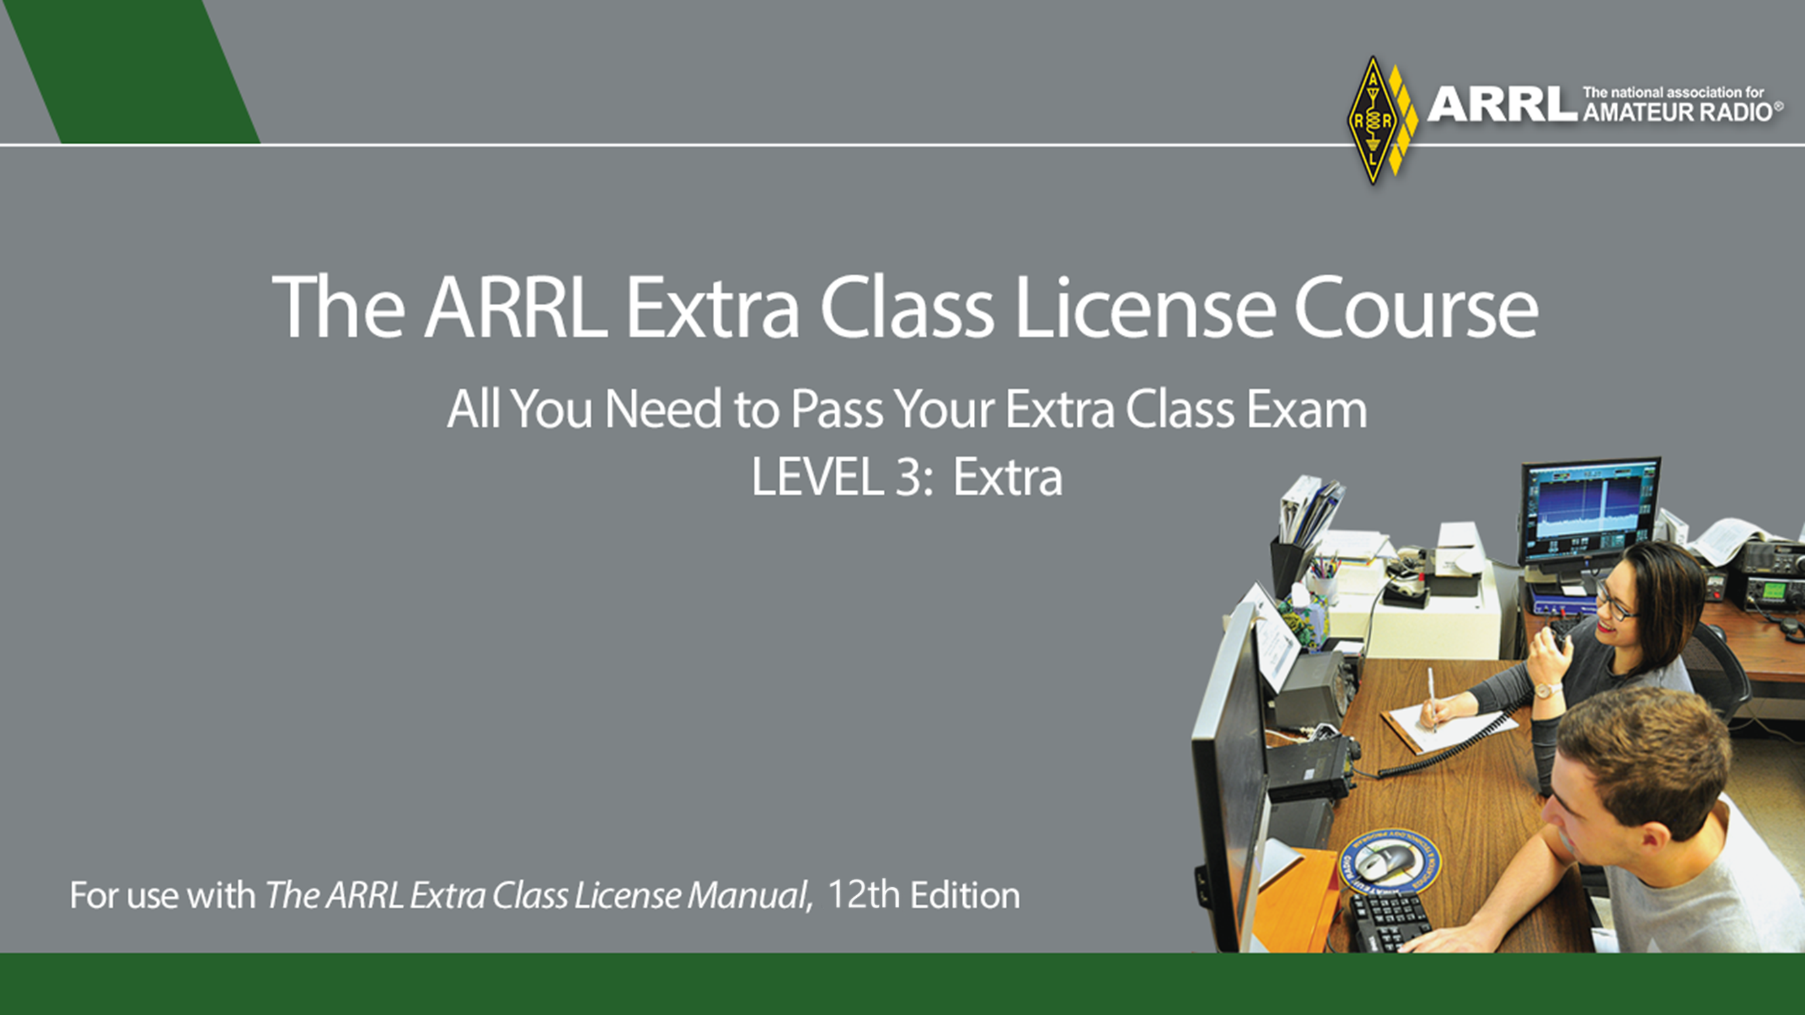

Slide 2
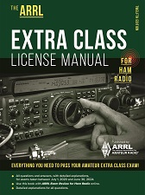
Extra License Manual
and other resources
http://www.arrl.org/shop/Licensing-Education-and-Training/

Slide 3
What is the typical output impedance of an op-amp?
A. Very low
B. Very high
C. 100 ohms
D. 1000 ohms
E7G01 ECLM Page (6 - 7)

Slide 4
What is the typical output impedance of an op-amp?
A. Very low
B. Very high
C. 100 ohms
D. 1000 ohms
(A) E7G01 ECLM Page (6 - 7)

Slide 5
What is ringing in a filter?
A. An echo caused by a long time delay
B. A reduction in high frequency response
C. Partial cancellation of the signal over a range of frequencies
D. Undesired oscillations added to the desired signal
E7G02 ECLM Page (6 - 36)

Slide 6
What is ringing in a filter?
A. An echo caused by a long time delay
B. A reduction in high frequency response
C. Partial cancellation of the signal over a range of frequencies
D. Undesired oscillations added to the desired signal
(D) E7G02 ECLM Page (6 - 36)

Slide 7
What is the typical input impedance of an op-amp?
A. 100 ohms
B. 1000 ohms
C. Very low
D. Very high
E7G03 ECLM Page (6 - 7)

Slide 8
What is the typical input impedance of an op-amp?
A. 100 ohms
B. 1000 ohms
C. Very low
D. Very high
(D) E7G03 ECLM Page (6 - 7)

Slide 9
What is meant by the term op-amp input offset voltage?
A. The output voltage of the op-amp minus its input voltage
B. The difference between the output voltage of the op-amp and the input voltage required in the immediately following stage
C. The differential input voltage needed to bring the open-loop output voltage to zero
D. The potential between the amplifier input terminals of the op-amp in an open-loop condition
E7G04 ECLM Page (6 - 8)

Slide 10
What is meant by the term op-amp input offset voltage?
A. The output voltage of the op-amp minus its input voltage
B. The difference between the output voltage of the op-amp and the input voltage required in the immediately following stage
C. The differential input voltage needed to bring the open-loop output voltage to zero
D. The potential between the amplifier input terminals of the op-amp in an open-loop condition
(C) E7G04 ECLM Page (6 - 8)

Slide 11
How can unwanted ringing and audio instability be prevented in an op-amp RC audio filter circuit?
A. Restrict both gain and Q
B. Restrict gain, but increase Q
C. Restrict Q, but increase gain
D. Increase both gain and Q
E7G05 ECLM Page (6 - 36)

Slide 12
How can unwanted ringing and audio instability be prevented in an op-amp RC audio filter circuit?
A. Restrict both gain and Q
B. Restrict gain, but increase Q
C. Restrict Q, but increase gain
D. Increase both gain and Q
(A) E7G05 ECLM Page (6 - 36)

Slide 13
What is the gain-bandwidth of an operational amplifier?
A. The maximum frequency for a filter circuit using that type of amplifier
B. The frequency at which the open-loop gain of the amplifier equals one
C. The gain of the amplifier at a filter's cutoff frequency
D. The frequency at which the amplifier's offset voltage is zero
E7G06 ECLM Page (6 - 7)

Slide 14
What is the gain-bandwidth of an operational amplifier?
A. The maximum frequency for a filter circuit using that type of amplifier
B. The frequency at which the open-loop gain of the amplifier equals one
C. The gain of the amplifier at a filter's cutoff frequency
D. The frequency at which the amplifier's offset voltage is zero
(B) E7G06 ECLM Page (6 - 7)

Slide 15
What magnitude of voltage gain can be expected from the circuit in Figure E7-3 when R1 is 10 ohms and RF is 470 ohms?
A. 0.21
B. 94
C. 47
D. 24
E7G07 ECLM Page (6 - 9)

Slide 16
What magnitude of voltage gain can be expected from the circuit in Figure E7-3 when R1 is 10 ohms and RF is 470 ohms?
A. 0.21
B. 94
C. 47
D. 24
(C) E7G07 ECLM Page (6 - 9)

Slide 17
How does the gain of an ideal operational amplifier vary with frequency?
A. It increases linearly with increasing frequency
B. It decreases linearly with increasing frequency
C. It decreases logarithmically with increasing frequency
D. It does not vary with frequency
E7G08 ECLM Page (6 - 7)

Slide 18
How does the gain of an ideal operational amplifier vary with frequency?
A. It increases linearly with increasing frequency
B. It decreases linearly with increasing frequency
C. It decreases logarithmically with increasing frequency
D. It does not vary with frequency
(D) E7G08 ECLM Page (6 - 7)

Slide 19
What will be the output voltage of the circuit shown in Figure E7-3 if R1 is 1000 ohms, RF is 10,000 ohms, and 0.23 volts DC is applied to the input?
A. 0.23 volts
B. 2.3 volts
C. -0.23 volts
D. -2.3 volts
E7G09 ECLM Page (6 - 9)

Slide 20
What will be the output voltage of the circuit shown in Figure E7-3 if R1 is 1000 ohms, RF is 10,000 ohms, and 0.23 volts DC is applied to the input?
A. 0.23 volts
B. 2.3 volts
C. -0.23 volts
D. -2.3 volts
(D) E7G09 ECLM Page (6 - 9)

Slide 21
What absolute voltage gain can be expected from the circuit in Figure E7-3 when R1 is 1800 ohms and RF is 68 kilohms?
A. 1
B. 0.03
C. 38
D. 76
E7G10 ECLM Page (6 - 9)

Slide 22
What absolute voltage gain can be expected from the circuit in Figure E7-3 when R1 is 1800 ohms and RF is 68 kilohms?
A. 1
B. 0.03
C. 38
D. 76
(C) E7G10 ECLM Page (6 - 9)

Slide 23
What absolute voltage gain can be expected from the circuit in Figure E7-3 when R1 is 3300 ohms and RF is 47 kilohms?
A. 28
B. 14
C. 7
D. 0.07
E7G11 ECLM Page (6 - 7)

Slide 24
What absolute voltage gain can be expected from the circuit in Figure E7-3 when R1 is 3300 ohms and RF is 47 kilohms?
A. 28
B. 14
C. 7
D. 0.07
(B ) E7G11 ECLM Page (6 - 7)

Slide 25
What is an operational amplifier?
A. A high-gain, direct-coupled differential amplifier with very high input impedance and very low output impedance
B. A digital audio amplifier whose characteristics are determined by components external to the amplifier
C. An amplifier used to increase the average output of frequency modulated amateur signals to the legal limit
D. A RF amplifier used in the UHF and microwave regions
E7G12 ECLM Page (6 - 7)

Slide 26
What is an operational amplifier?
A. A high-gain, direct-coupled differential amplifier with very high input impedance and very low output impedance
B. A digital audio amplifier whose characteristics are determined by components external to the amplifier
C. An amplifier used to increase the average output of frequency modulated amateur signals to the legal limit
D. A RF amplifier used in the UHF and microwave regions
(A) E7G12 ECLM Page (6 - 7)

Slide 27
What are three oscillator circuits used in amateur radio equipment?
A. Taft, Pierce and negative feedback
B. Pierce, Fenner and Beane
C. Taft, Hartley and Pierce
D. Colpitts, Hartley and Pierce
E7H01 ECLM Page (6 - 15)

Slide 28
What are three oscillator circuits used in amateur radio equipment?
A. Taft, Pierce and negative feedback
B. Pierce, Fenner and Beane
C. Taft, Hartley and Pierce
D. Colpitts, Hartley and Pierce
(D) E7H01 ECLM Page (6 - 15)

Slide 29
What is a microphonic?
A. An IC used for amplifying microphone signals
B. Distortion caused by RF pickup on the microphone cable
C. Changes in oscillator frequency due to mechanical vibration
D. Excess loading of the microphone by an oscillator
E7H02 ECLM Page (6 - 16)

Slide 30
What is a microphonic?
A. An IC used for amplifying microphone signals
B. Distortion caused by RF pickup on the microphone cable
C. Changes in oscillator frequency due to mechanical vibration
D. Excess loading of the microphone by an oscillator
(C) E7H02 ECLM Page (6 - 16)

Slide 31
How is positive feedback supplied in a Hartley oscillator?
A. Through a tapped coil
B. Through a capacitive divider
C. Through link coupling
D. Through a neutralizing capacitor
E7H03 ECLM Page (6 - 14)

Slide 32
How is positive feedback supplied in a Hartley oscillator?
A. Through a tapped coil
B. Through a capacitive divider
C. Through link coupling
D. Through a neutralizing capacitor
(A) E7H03 ECLM Page (6 - 14)

Slide 33
How is positive feedback supplied in a Colpitts oscillator?
A. Through a tapped coil
B. Through link coupling
C. Through a capacitive divider
D. Through a neutralizing capacitor
E7H04 ECLM Page (6 - 14)

Slide 34
How is positive feedback supplied in a Colpitts oscillator?
A. Through a tapped coil
B. Through link coupling
C. Through a capacitive divider
D. Through a neutralizing capacitor
(C) E7H04 ECLM Page (6 - 14)

Slide 35
How is positive feedback supplied in a Pierce oscillator?
A. Through a tapped coil
B. Through link coupling
C. Through a neutralizing capacitor
D. Through a quartz crystal
E7H05 ECLM Page (6 - 15)

Slide 36
How is positive feedback supplied in a Pierce oscillator?
A. Through a tapped coil
B. Through link coupling
C. Through a neutralizing capacitor
D. Through a quartz crystal
(D) E7H05 ECLM Page (6 - 15)

Slide 37
Which of the following oscillator circuits are commonly used in VFOs?
A. Pierce and Zener
B. Colpitts and Hartley
C. Armstrong and deForest
D. Negative feedback and balanced feedback
E7H06 ECLM Page (6 - 15)

Slide 38
Which of the following oscillator circuits are commonly used in VFOs?
A. Pierce and Zener
B. Colpitts and Hartley
C. Armstrong and deForest
D. Negative feedback and balanced feedback
(B) E7H06 ECLM Page (6 - 15)

Slide 39
How can an oscillator’s microphonic responses be reduced?
A. Use NP0 capacitors
B. Reduce noise on the oscillator’s power supply
C. Increase the bias voltage
D. Mechanically isolate the oscillator circuitry from its enclosure
E7H07 ECLM Page (6 - 16)

Slide 40
How can an oscillator’s microphonic responses be reduced?
A. Use NP0 capacitors
B. Reduce noise on the oscillator’s power supply
C. Increase the bias voltage
D. Mechanically isolate the oscillator circuitry from its enclosure
(D) E7H07 ECLM Page (6 - 16)

Slide 41
Which of the following components can be used to reduce thermal drift in crystal oscillators?
A. NP0 capacitors
B. Toroidal inductors
C. Wirewound resistors
D. Non-inductive resistors
E7H08 ECLM Page (6 - 16)

Slide 42
Which of the following components can be used to reduce thermal drift in crystal oscillators?
A. NP0 capacitors
B. Toroidal inductors
C. Wirewound resistors
D. Non-inductive resistors
(A) E7H08 ECLM Page (6 - 16)

Slide 43
What type of frequency synthesizer circuit uses a phase accumulator, lookup table, digital to analog converter, and a low-pass anti-alias filter?
A. A direct digital synthesizer
B. A hybrid synthesizer
C. A phase locked loop synthesizer
D. A diode-switching matrix synthesizer
E7H09 ECLM Page (6 - 17)

Slide 44
What type of frequency synthesizer circuit uses a phase accumulator, lookup table, digital to analog converter, and a low-pass anti-alias filter?
A. A direct digital synthesizer
B. A hybrid synthesizer
C. A phase locked loop synthesizer
D. A diode-switching matrix synthesizer
(A) E7H09 ECLM Page (6 - 17)

Slide 45
What information is contained in the lookup table of a direct digital synthesizer (DDS)?
A. The phase relationship between a reference oscillator and the output waveform
B. Amplitude values that represent the desired waveform
C. The phase relationship between a voltage-controlled oscillator and the output waveform
D. Frequently used receiver and transmitter frequencies
E7H10 ECLM Page (6 - 17)

Slide 46
What information is contained in the lookup table of a direct digital synthesizer (DDS)?
A. The phase relationship between a reference oscillator and the output waveform
B. Amplitude values that represent the desired waveform
C. The phase relationship between a voltage-controlled oscillator and the output waveform
D. Frequently used receiver and transmitter frequencies
(B) E7H10 ECLM Page (6 - 17)

Slide 47
What are the major spectral impurity components of direct digital synthesizers?
A. Broadband noise
B. Digital conversion noise
C. Spurious signals at discrete frequencies
D. Nyquist limit noise
E7H11 ECLM Page (6 - 17)

Slide 48
What are the major spectral impurity components of direct digital synthesizers?
A. Broadband noise
B. Digital conversion noise
C. Spurious signals at discrete frequencies
D. Nyquist limit noise
(C) E7H11 ECLM Page (6 - 17)

Slide 49
Which of the following must be done to ensure that a crystal oscillator provides the frequency specified by the crystal manufacturer?
A. Provide the crystal with a specified parallel inductance
B. Provide the crystal with a specified parallel capacitance
C. Bias the crystal at a specified voltage
D. Bias the crystal at a specified current
E7H12 ECLM Page (6 - 16)

Slide 50
Which of the following must be done to ensure that a crystal oscillator provides the frequency specified by the crystal manufacturer?
A. Provide the crystal with a specified parallel inductance
B. Provide the crystal with a specified parallel capacitance
C. Bias the crystal at a specified voltage
D. Bias the crystal at a specified current
(B) E7H12 ECLM Page (6 - 16)

Slide 51
Which of the following is a technique for providing highly accurate and stable oscillators needed for microwave transmission and reception?
A. Use a GPS signal reference
B. Use a rubidium stabilized reference oscillator
C. Use a temperature-controlled high Q dielectric resonator
D. All these choices are correct
E7H13 ECLM Page (6 - 15)

Slide 52
Which of the following is a technique for providing highly accurate and stable oscillators needed for microwave transmission and reception?
A. Use a GPS signal reference
B. Use a rubidium stabilized reference oscillator
C. Use a temperature-controlled high Q dielectric resonator
D. All these choices are correct
(D) E7H13 ECLM Page (6 - 15)

Slide 53
What is a phase-locked loop circuit?
A. An electronic servo loop consisting of a ratio detector, reactance modulator, and voltage-controlled oscillator
B. An electronic circuit also known as a monostable multivibrator
C. An electronic servo loop consisting of a phase detector, a low-pass filter, a voltage-controlled oscillator, and a stable reference oscillator
D. An electronic circuit consisting of a precision push-pull amplifier with a differential input
E7H14 ECLM Page (6 - 18)

Slide 54
What is a phase-locked loop circuit?
A. An electronic servo loop consisting of a ratio detector, reactance modulator, and voltage-controlled oscillator
B. An electronic circuit also known as a monostable multivibrator
C. An electronic servo loop consisting of a phase detector, a low-pass filter, a voltage-controlled oscillator, and a stable reference oscillator
D. An electronic circuit consisting of a precision push-pull amplifier with a differential input
(C) E7H14 ECLM Page (6 - 18)

Slide 55
Which of these functions can be performed by a phase-locked loop?
A. Wide-band AF and RF power amplification
B. Comparison of two digital input signals, digital pulse counter
C. Photovoltaic conversion, optical coupling
D. Frequency synthesis, FM demodulation
E7H15 ECLM Page (6 - 19)

Slide 56
Which of these functions can be performed by a phase-locked loop?
A. Wide-band AF and RF power amplification
B. Comparison of two digital input signals, digital pulse counter
C. Photovoltaic conversion, optical coupling
D. Frequency synthesis, FM demodulation
(D) E7H15 ECLM Page (6 - 19)

