Slide 1

2010 CMARC Youth Program

Slide 2
Topics
HHS Communications
MRAY Network
Position

Slide 3


#1 HHS Communications Club

Slide 4
(#1) HHS Communications Club
WE HAVE A ROOM!
After 3 years of hard work we do have a room for the equipment to be housed in, and a place to meet.
The equipment will be behind TWO locked doors.
The power to all the equipment will be a key-lock-switch
We have talked about housing the equipment inside of cabinets with individual locking doors.
This equipment will DEFINITELY be safe.
The room is in a perfect location for shooting video for the video broadcast side of the club! This will hopefully bring more people into the club so we can teach them about Ham Radio.

Slide 5
(#1) HHS Communication Club Goals
1
2
3
We have the room, we have been approved as a club. We’re good to go.
Let’s get this equipment IN the room!
We have 3 members already who are licensed Amateur Radio Operators.
It’s time to get more people interested and licensed in our club.
Once our membership grows, it’s time to show the school exactly what this hobby is about.
NASA talks, special events, & emergency services are all great ways to attract more people.

Slide 6

#2 MRAY Net

Slide 7
(#1) MRAY Net
New
&
Improved!
A
Moving BACK to the 145.390!
B
WORLDWIDE Check-Ins via Echolink
C
MRAY Net goes Tech Savy with LIVE webcam
D
MRAY Welcomes back Hams of ALL ages

Slide 8
(#2) MRAY Net
The W8HVG Link System was great, just not for us. We appreciate the time we spent there!
We will still make the net comfortable for young hams who aren’t comfortable talking to people who aren’t their own age.
Similar to the Ladies’ Tea Time Net, we will have a period at the beginning of the net where ONLY young people can check in.
Welcoming back Hams of all ages will be a good mentor program.
We want our Hams over the age of 22 to be comfortable as well, inviting everyone back will make everyone comfortable and increase our 3rd party check ins.

Slide 9
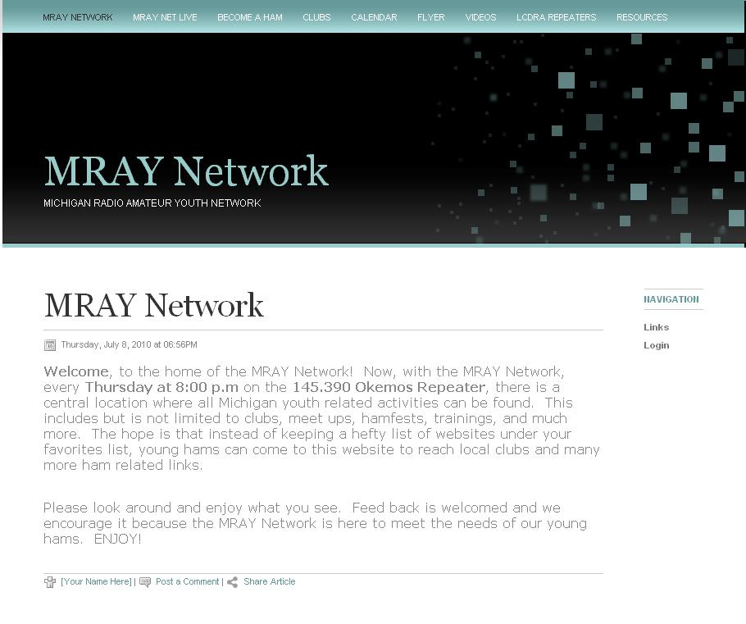
(#2) MRAY Net
New Website!

Slide 10
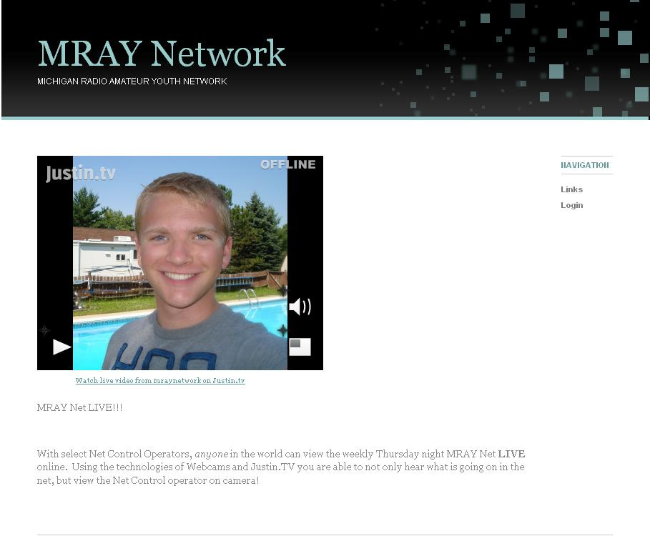
(#2) MRAY Net LIVE
View the Net Control Operator LIVE!

Slide 11


#3 Position?

Slide 12
#3 ARRL Assistant Section Manager
As of Wednesday July 7th, I have officially been appointed as an Assistant Section Manager!
I am the successor to Simon Boehme KC8ZYD.
I am now 1 of 3 ASMs (Assistant Section Managers) under Dale Williams WA8EFK. I am responsible for all things Youth Related in Michigan.

Slide 13
(#3) ARRL Assistant Section Manager
1
2
3
We will be publishing a monthly Newsletter that will go out to all the Michigan Clubs. This will include exciting news about anything Youth Related in Michigan.
Similar to the Youth Conference in the Spring of 2008. We will be establishing Youth Meet-Ups. This will provide the chance for young people to get to know each other, so we can hear them on the air!
The communication I now have with ALL Michigan clubs in an official Capacity with the ARRL will help involve more youth. I will be assisting Michigan Clubs with ways to involve Youth. I hope all Michigan clubs will be eventually affiliated with MRAY!
I am very excited about what this means for our Michigan!

Slide 14

1…2…3… CONNECTED!
ARRL
HHS Communications
Concept
MRAY

Slide 15
1…2…3…Connected!
Change in the Michigan Youth Program
203
HHS Communications
ARRL
2002
The success (FINALLY) with
the HHS Communications Club
Will not only attract young people
locally. This will provide a
platform for clubs throughout
Michigan to follow and use
for encouragement!
I can now in an official
capacity, excite and encourage MI clubs to follow in CMARC’s footsteps and involve the youth!
2001
MRAY Network
The MRAY Network will connect
Youth every week on the net and
every few months with meet-ups!

Slide 16
Change in the Michigan Youth Program
Thank You so much for the support and patience CMARC!
I’m very excited about all of the great changes and improvements we are going to start seeing for Michigan Youth! This has all come together in about the past month and it has been hard to keep quiet!
The 3 major topics I’ve announced are all connected and, I can’t say how ecstatic I am that everything has finally materialized. This is a reality!

Slide 17
2010 CMARC Youth Program
Thank You !

